Slide 1




Unfolding the Charm of Atmospheric Muons
Pascal Gutjahr
September 3, 2025
Source: NASA

Slide 2
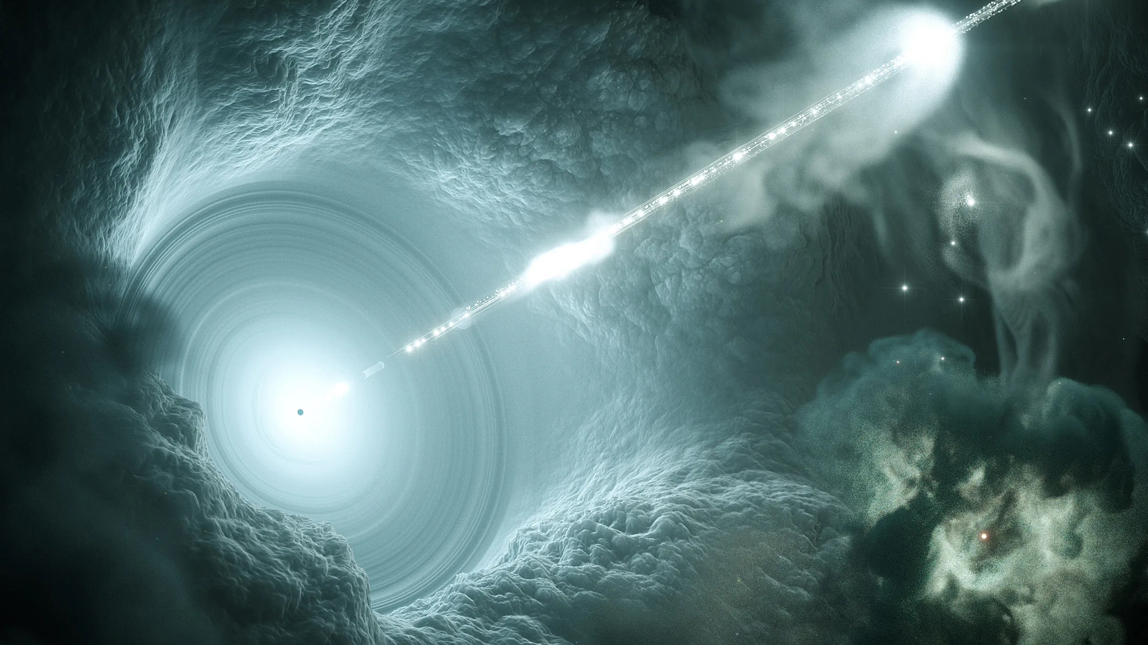

Slide 3

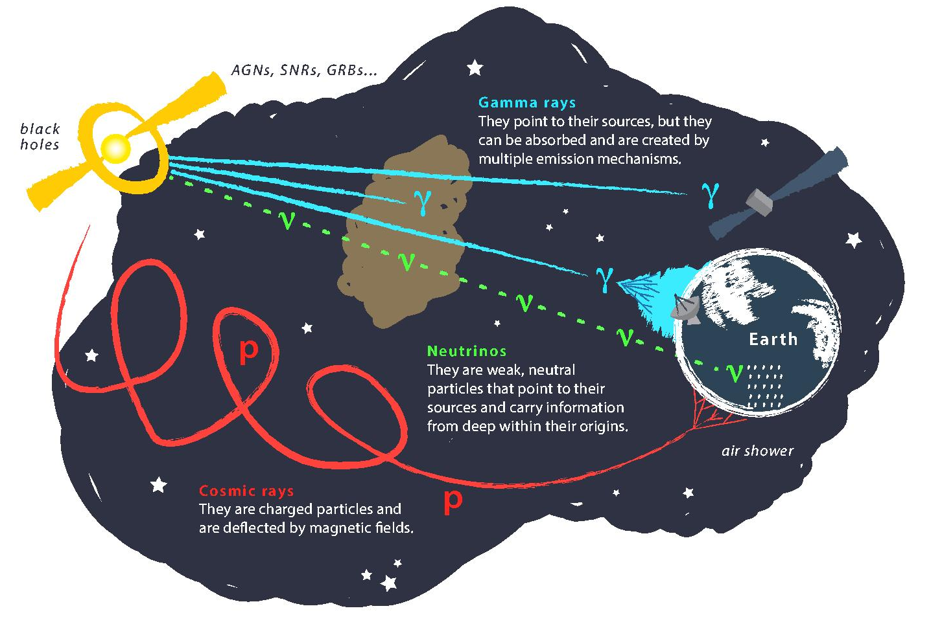
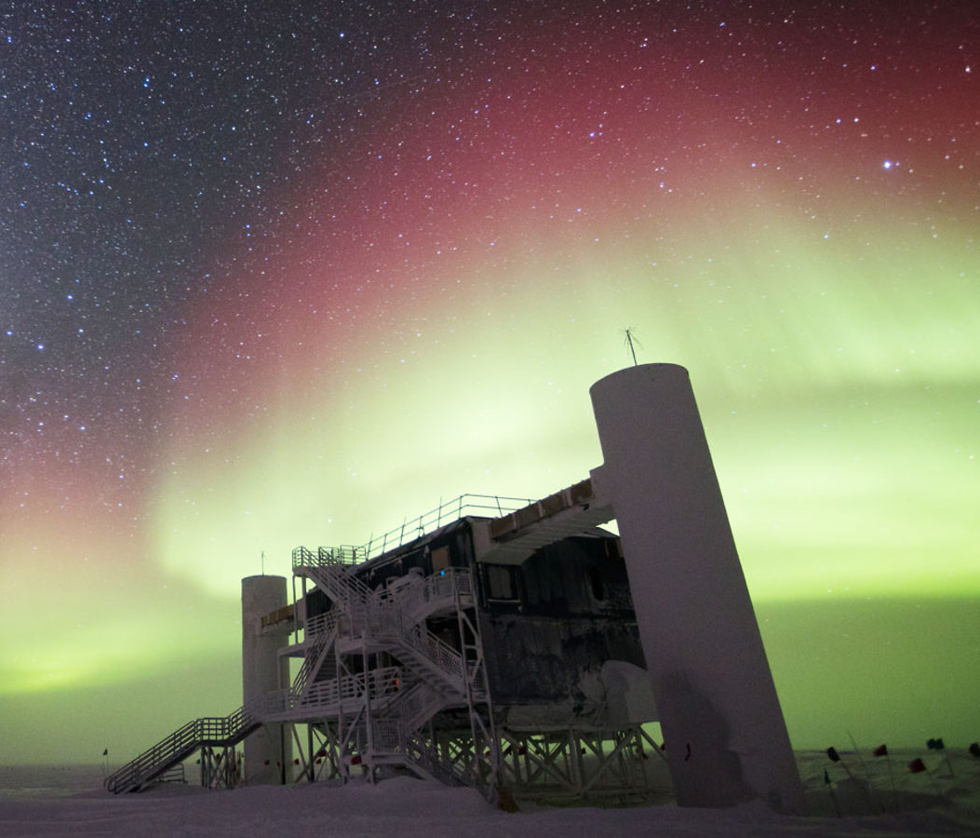
Astroparticle physics
Question: How many muons are produced?
Credit: IceCube / NSF
Source: Nasa
Source: gallery.icecube.wisc.edu

Slide 4
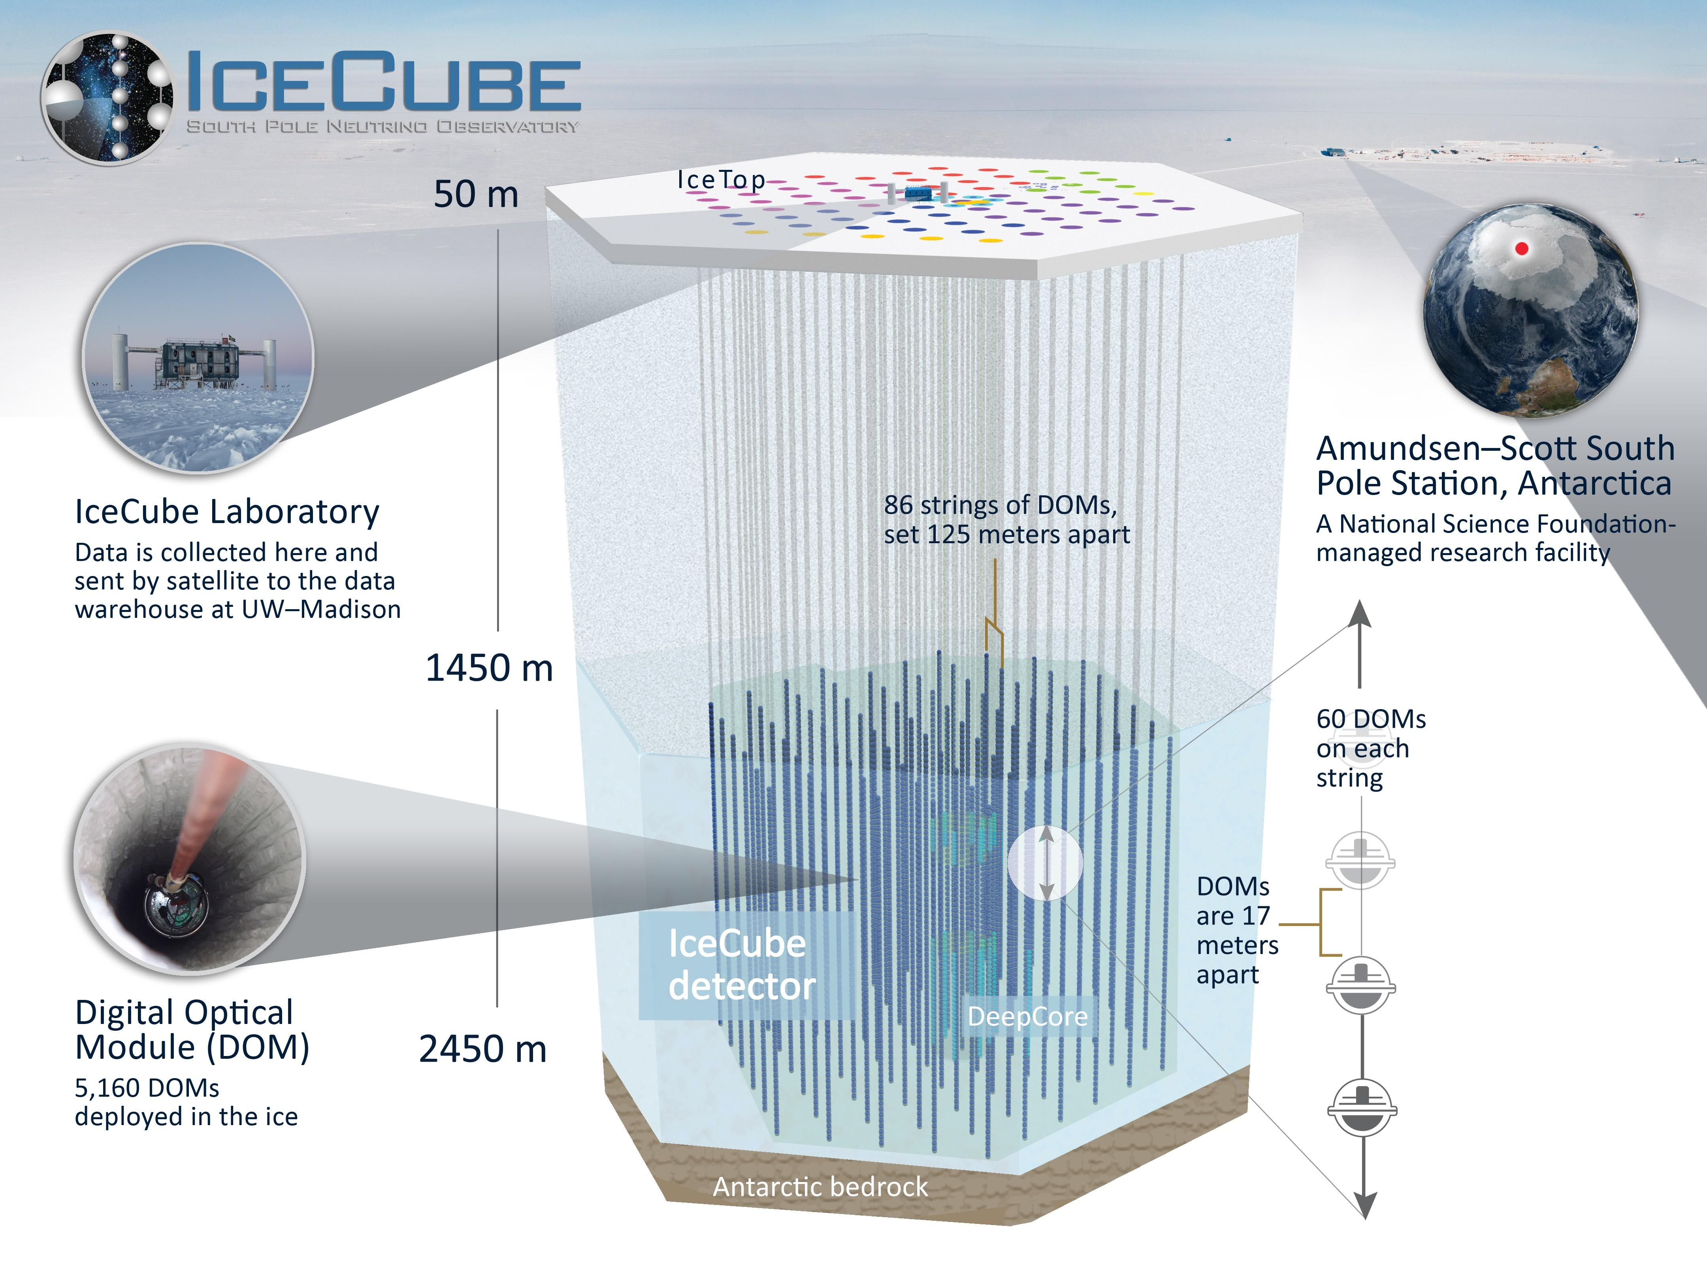
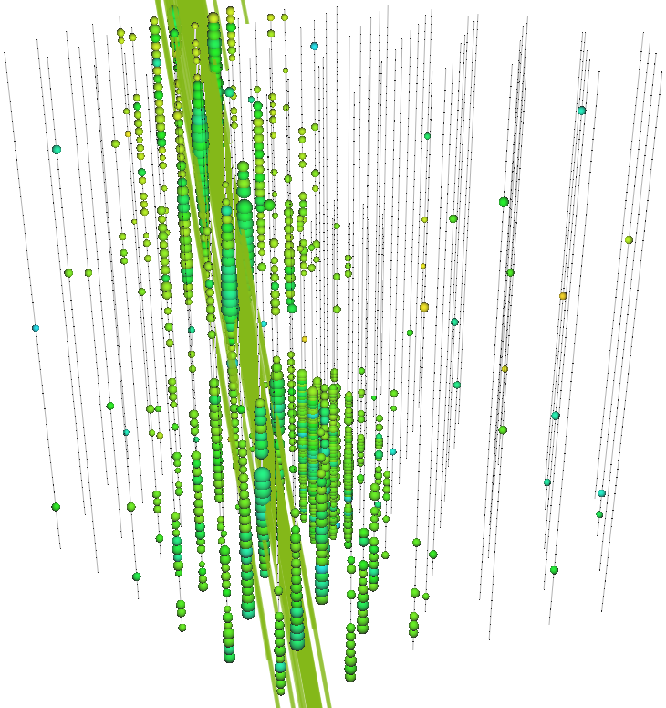
Credit: IceCube

Slide 5
Technical Basics
Unfolding and Machine Learning

Slide 6
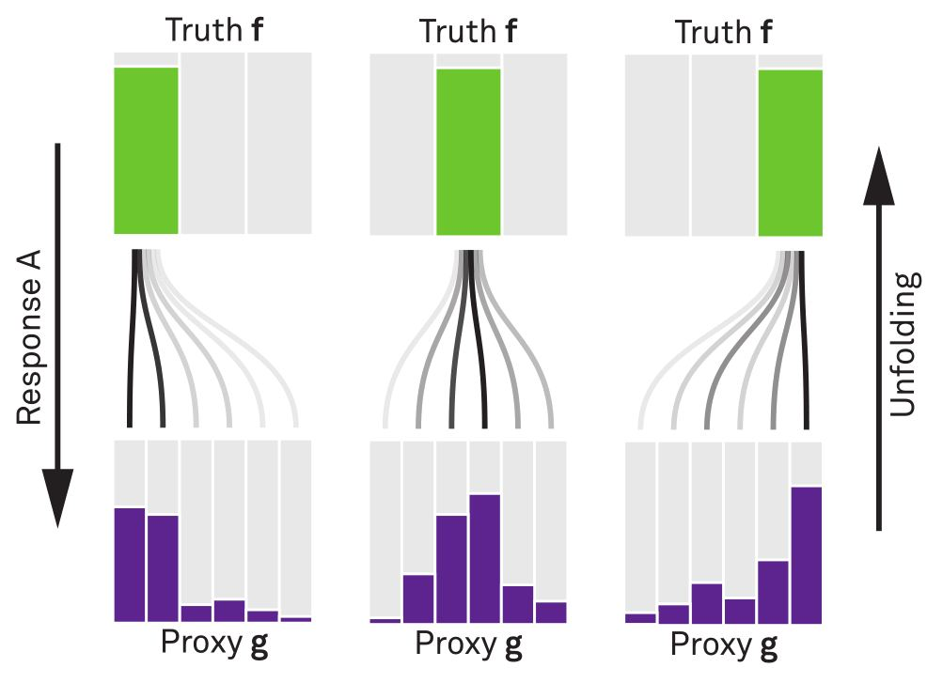


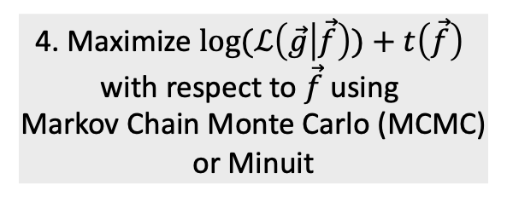
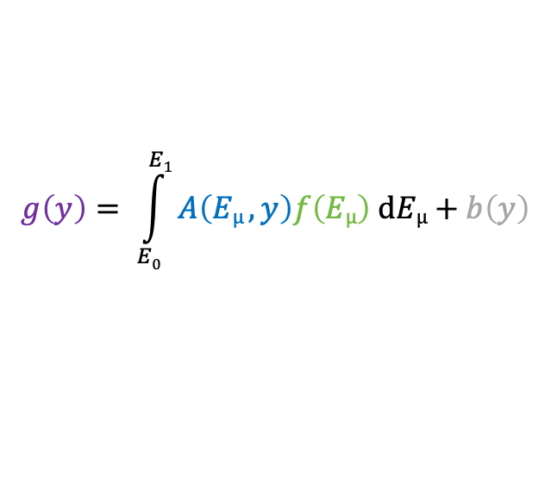
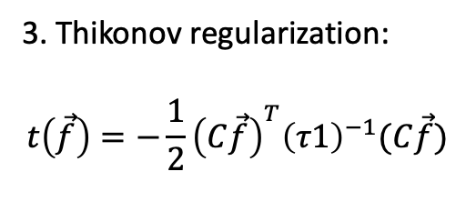
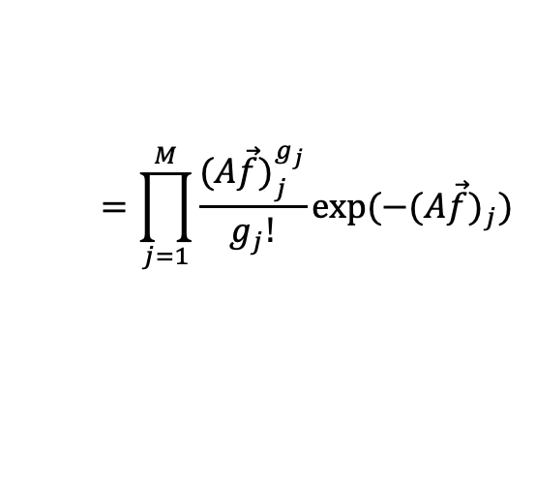
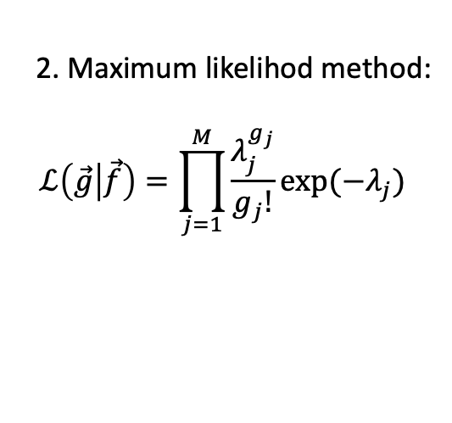
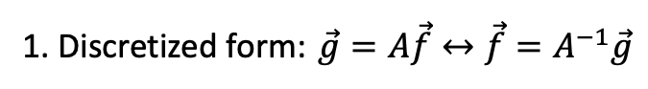
Unfolding in a nutshell
folding
unfolding
detector response
1. Discretized form: $\vec{g}=A\vec{f}↔\vec{f}=A^{−1}\vec{g}$
measured proxy
background
$$g\left(y\right)= \int_{E0}^{E1}{A\left(Eµ , y\right)f\left(Eµ\right) dEµ+b\left(y\right) }$$
2. Maximum likelihod method:
$$ℒ\left(\vec{g} | \vec{f}\right)=\prod_{j=1}^{M}{\frac{λ_{j}^{g_{j}}}{g_{j}!}exp⁡(−λ_{j})}$$
3. Thikonov regularization:
$$t\left(\vec{f}\right)=−\frac{1}{2}{\left(C\vec{f}\right)}^{T}{\left(τ1\right)}^{−1}(C\vec{f})$$
true energy distribution
$$=\prod_{j=1}^{M}{\frac{{(A\vec{f})}_{j}^{g_{j}}}{g_{j}!}exp⁡(−{(A\vec{f})}_{j})}$$
funfolding
by M. Börner
4. Maximize $log⁡(ℒ\left(\vec{g} | \vec{f}\right))+t\left(\vec{f}\right)$
with respect to $\vec{f}$ using
Markov Chain Monte Carlo (MCMC)
or Minuit
Credit: T. Hoinka

Slide 7
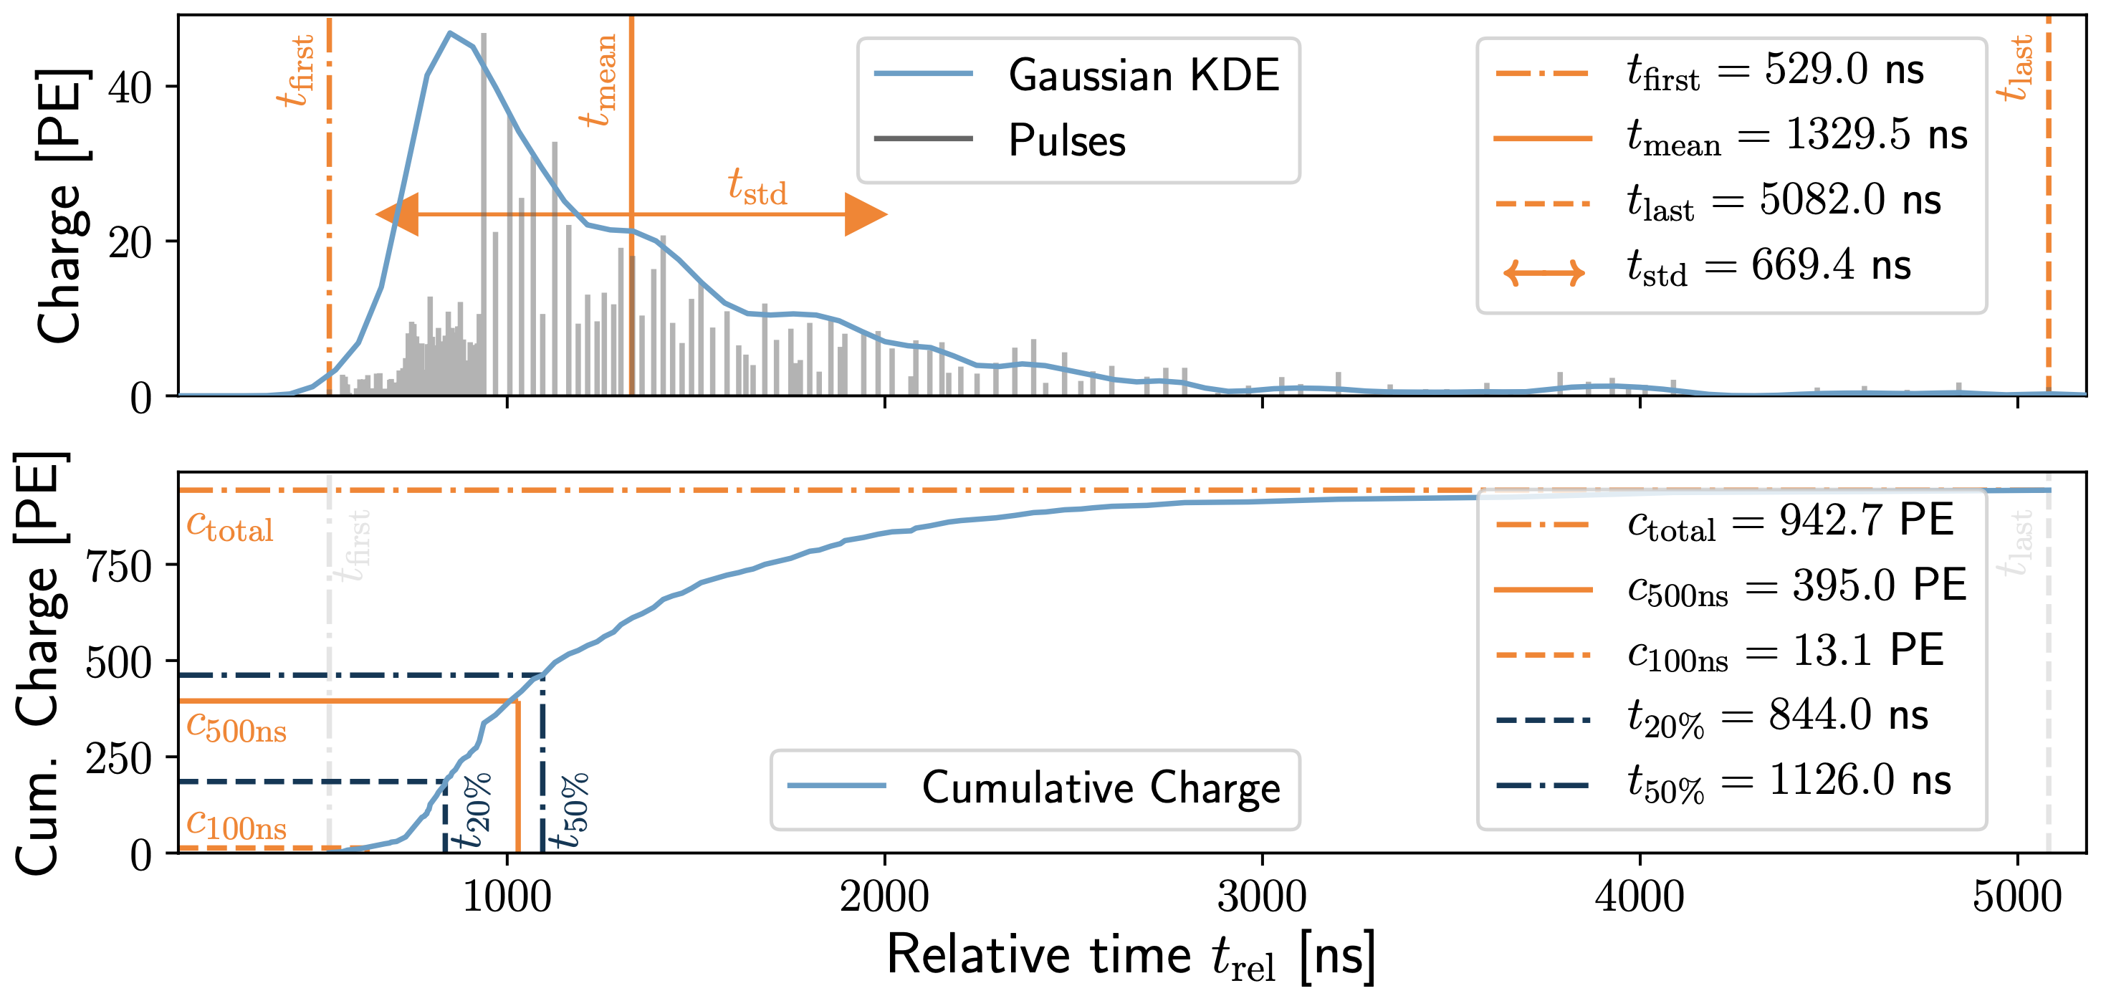
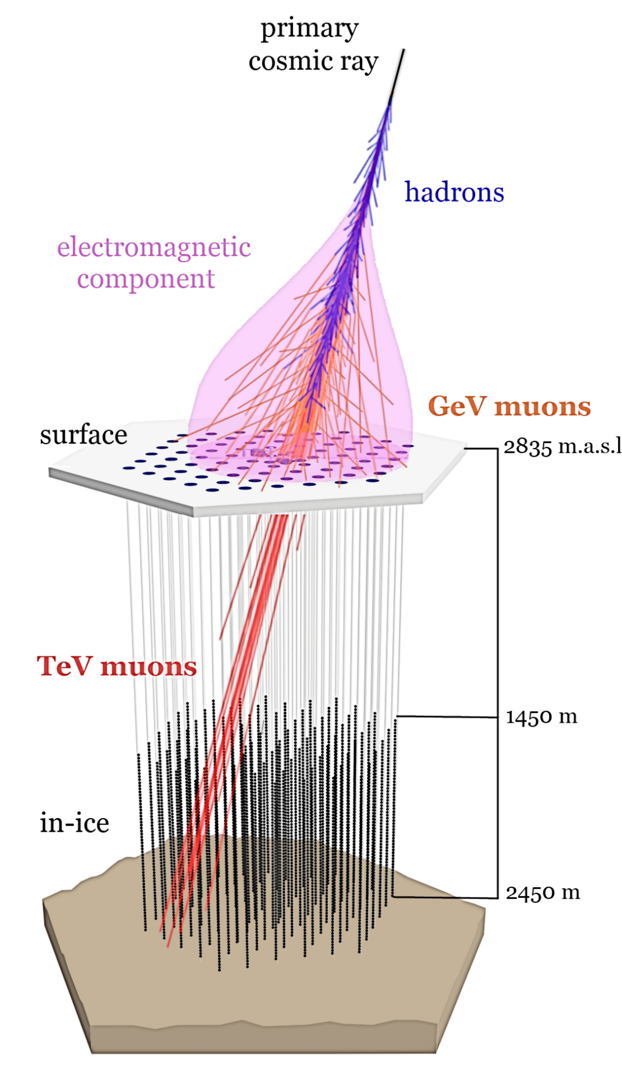
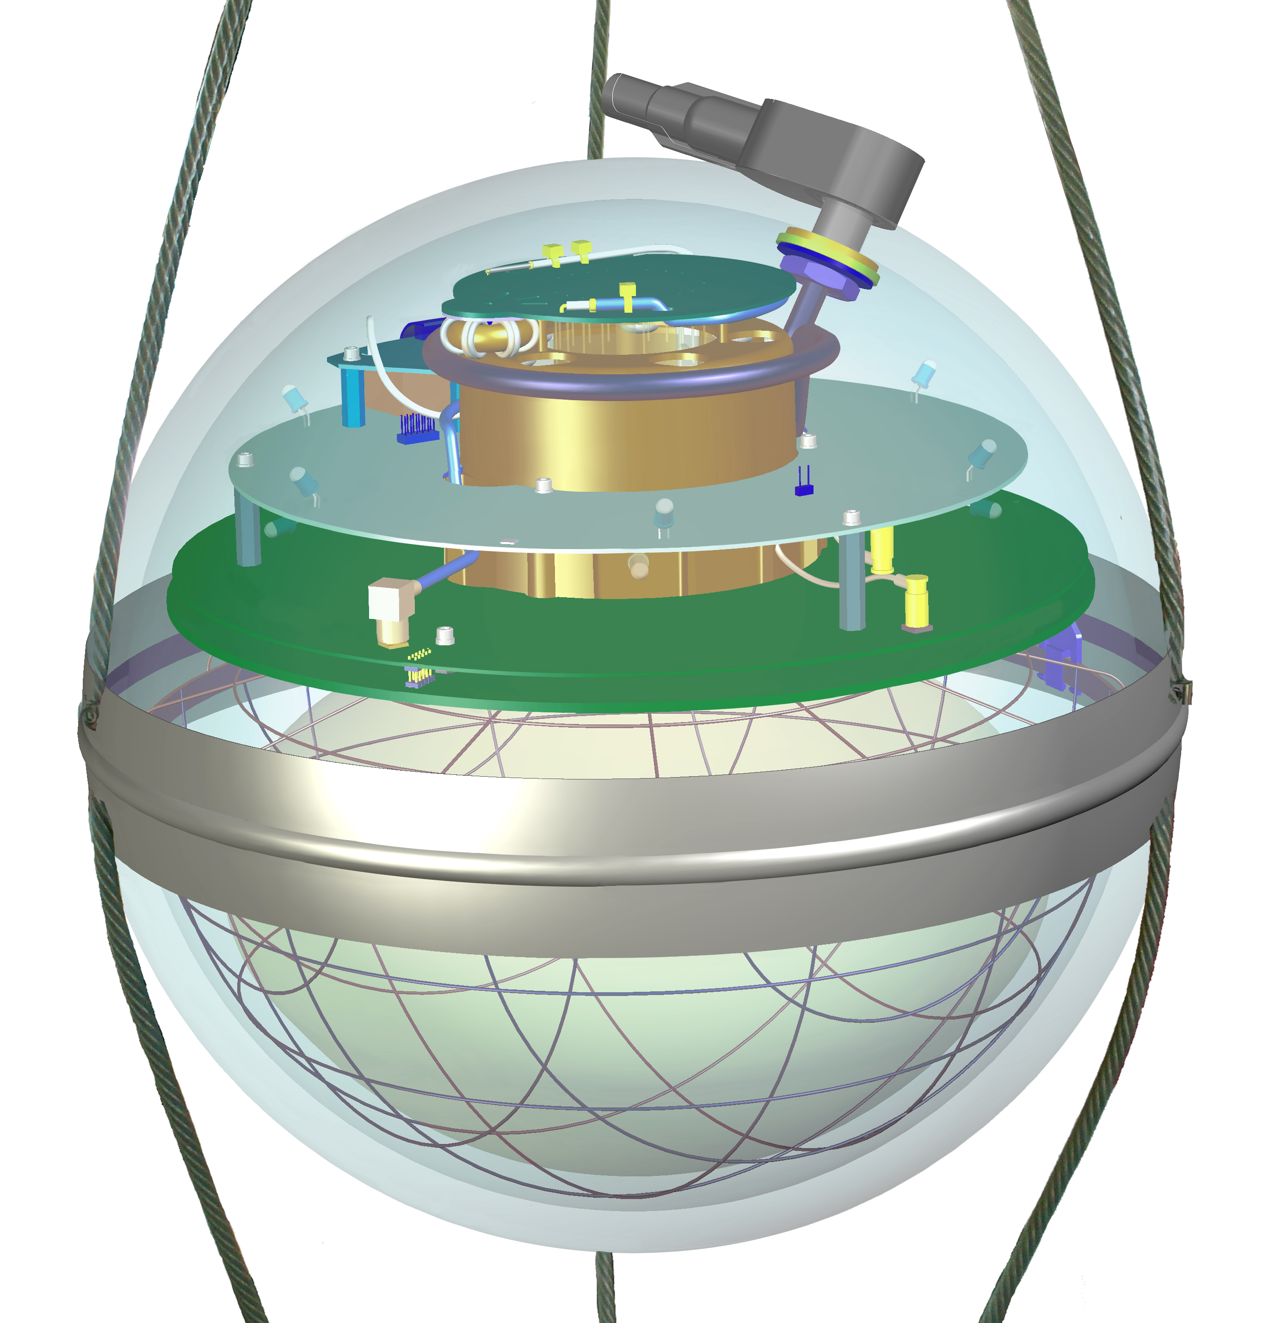
Machine Learning Reconstructions
10.1088/1748-0221/16/07/P07041
Credit: IceCube
Convolutional Neural Network
Inputs
c_{total}: Total charge
Sum of charge
t_{first}: Relative time of first pulse
Relative to total time offset
t_{std}: Standard deviation of first pulse
Charge weighted standard deviation of pulse times
Outputs
Direction
Stopping point
Entry point
Energy at entry/surface
…
Credit: IceCube

Slide 8
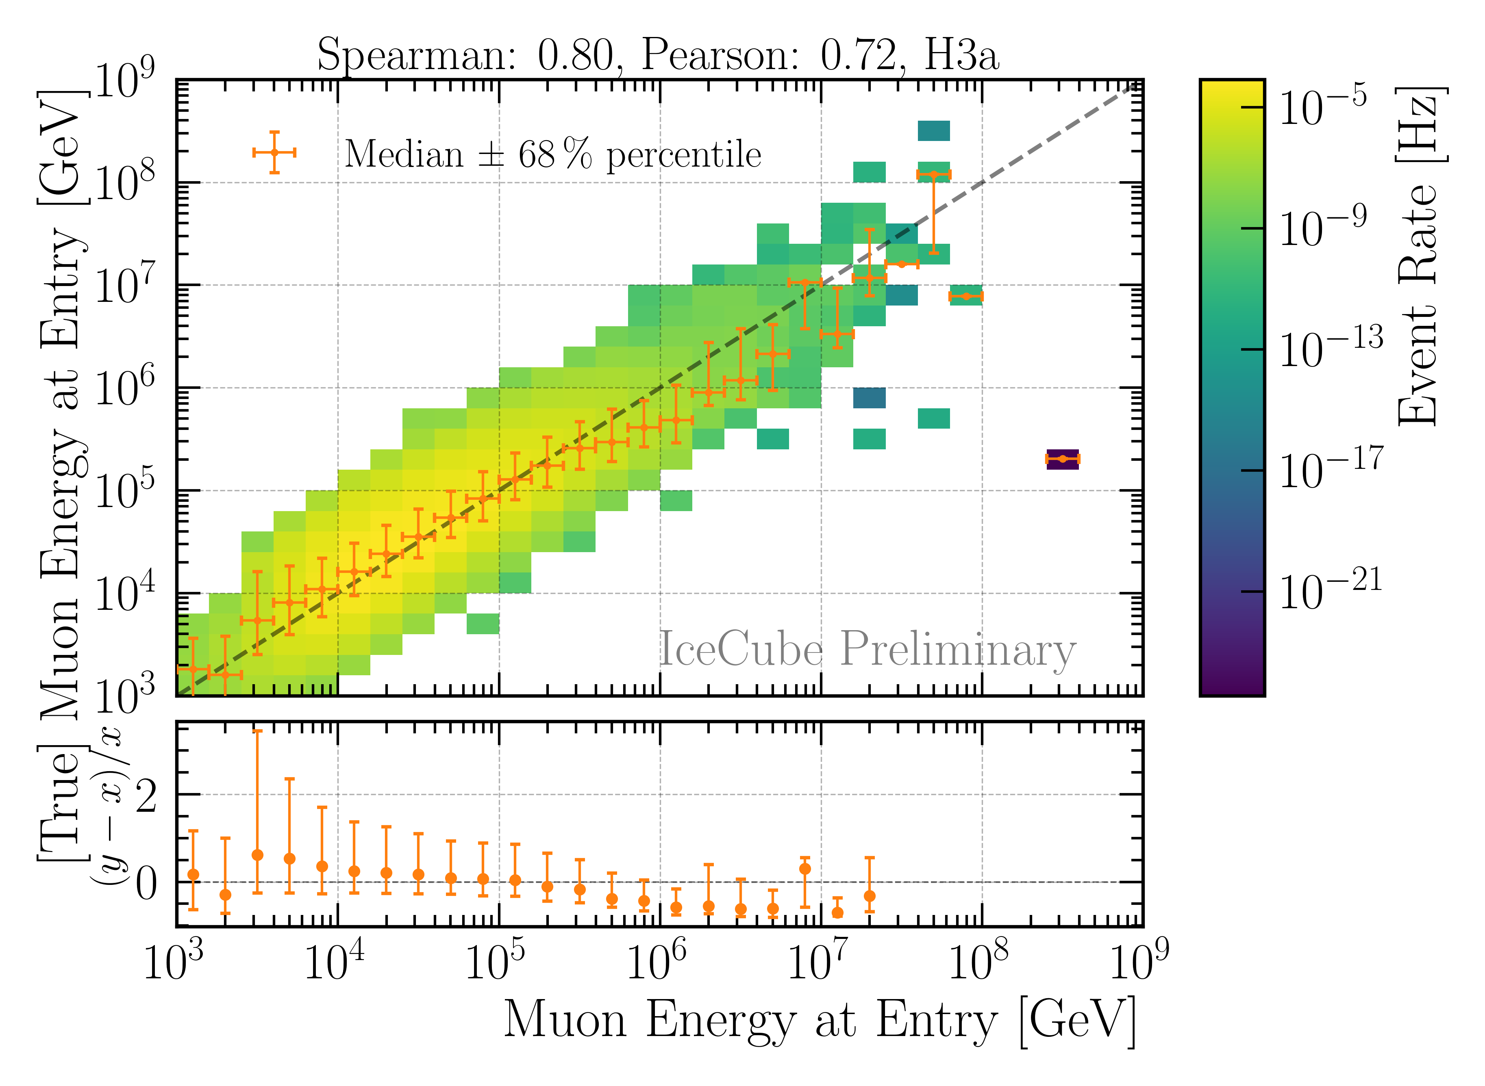
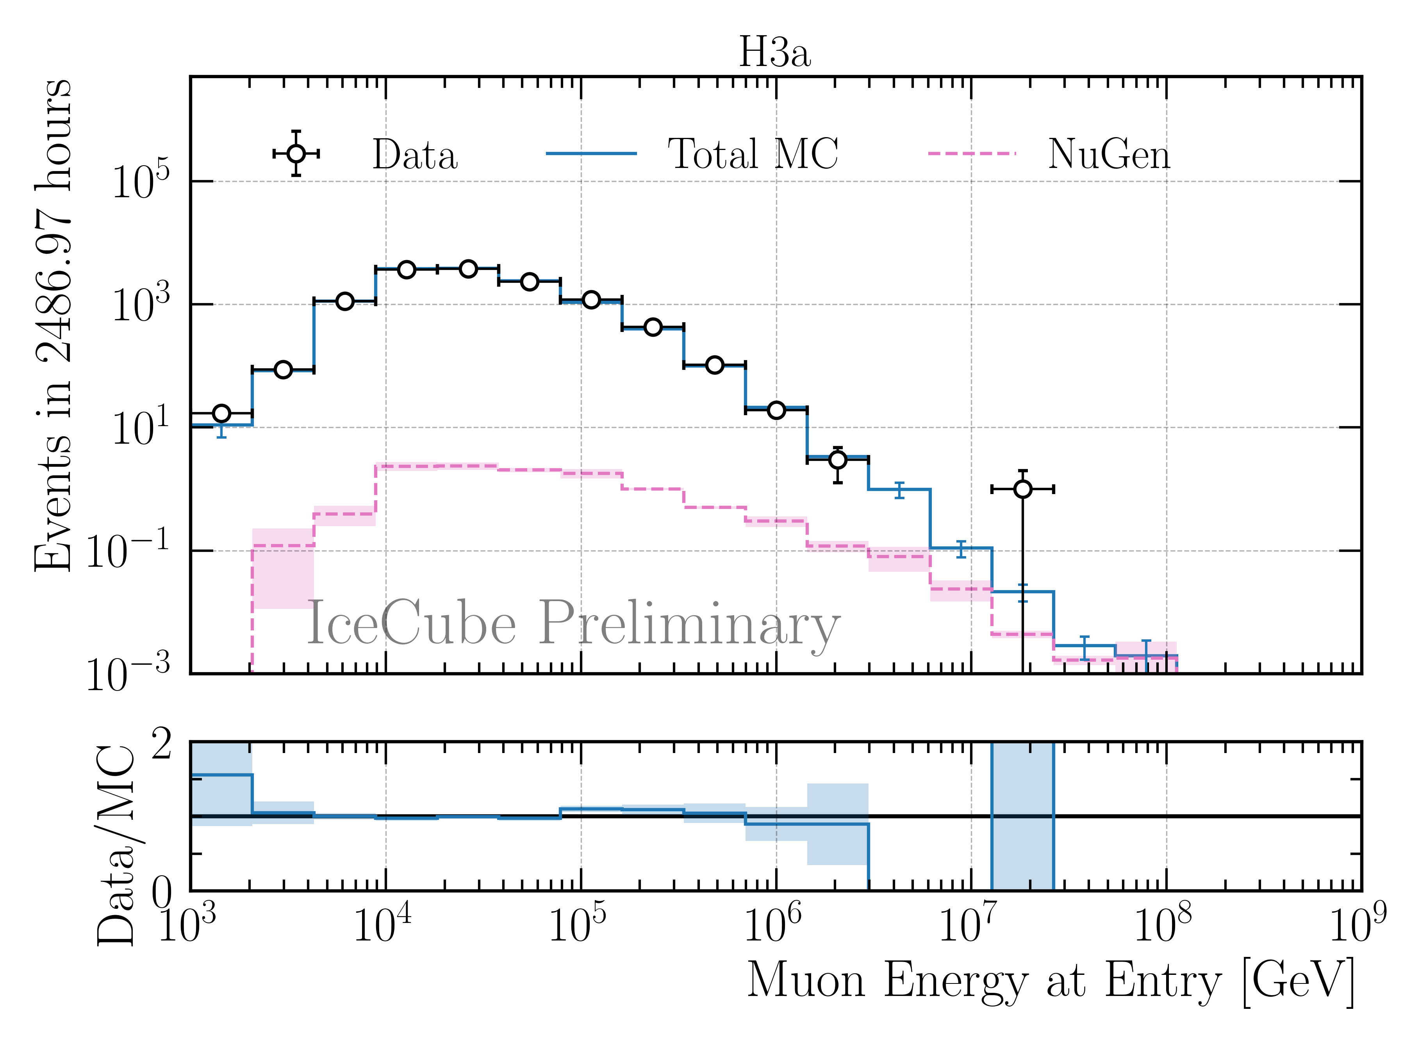
Reconstruction and Data—MC: Leading Muons
Good reconstruction of leading muon energy → proxy
Good data—MC agreement
Global offset → upscale MC by 12%

Slide 9
Muon Flux Unfolding

Slide 10
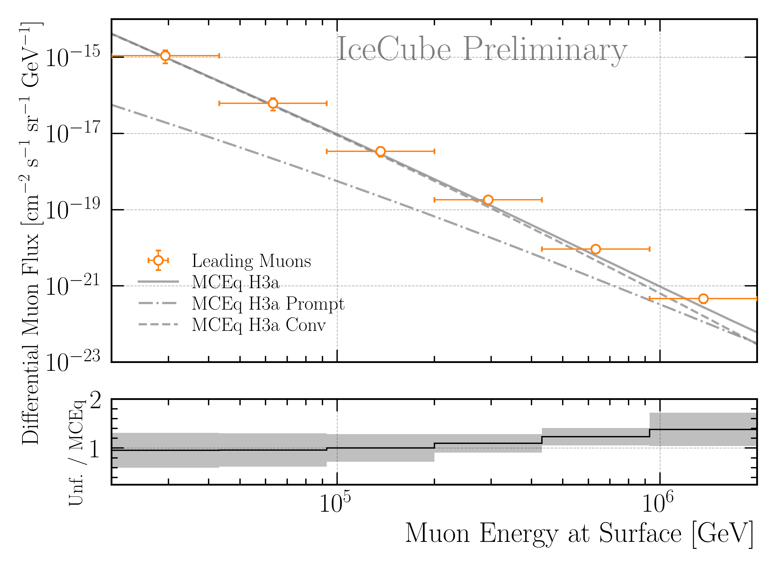
Muon Flux Unfolding
Leading muons
2487 h IceCube data
12754 events
Agrees with prediction

Slide 11
But what is charming?

Slide 12
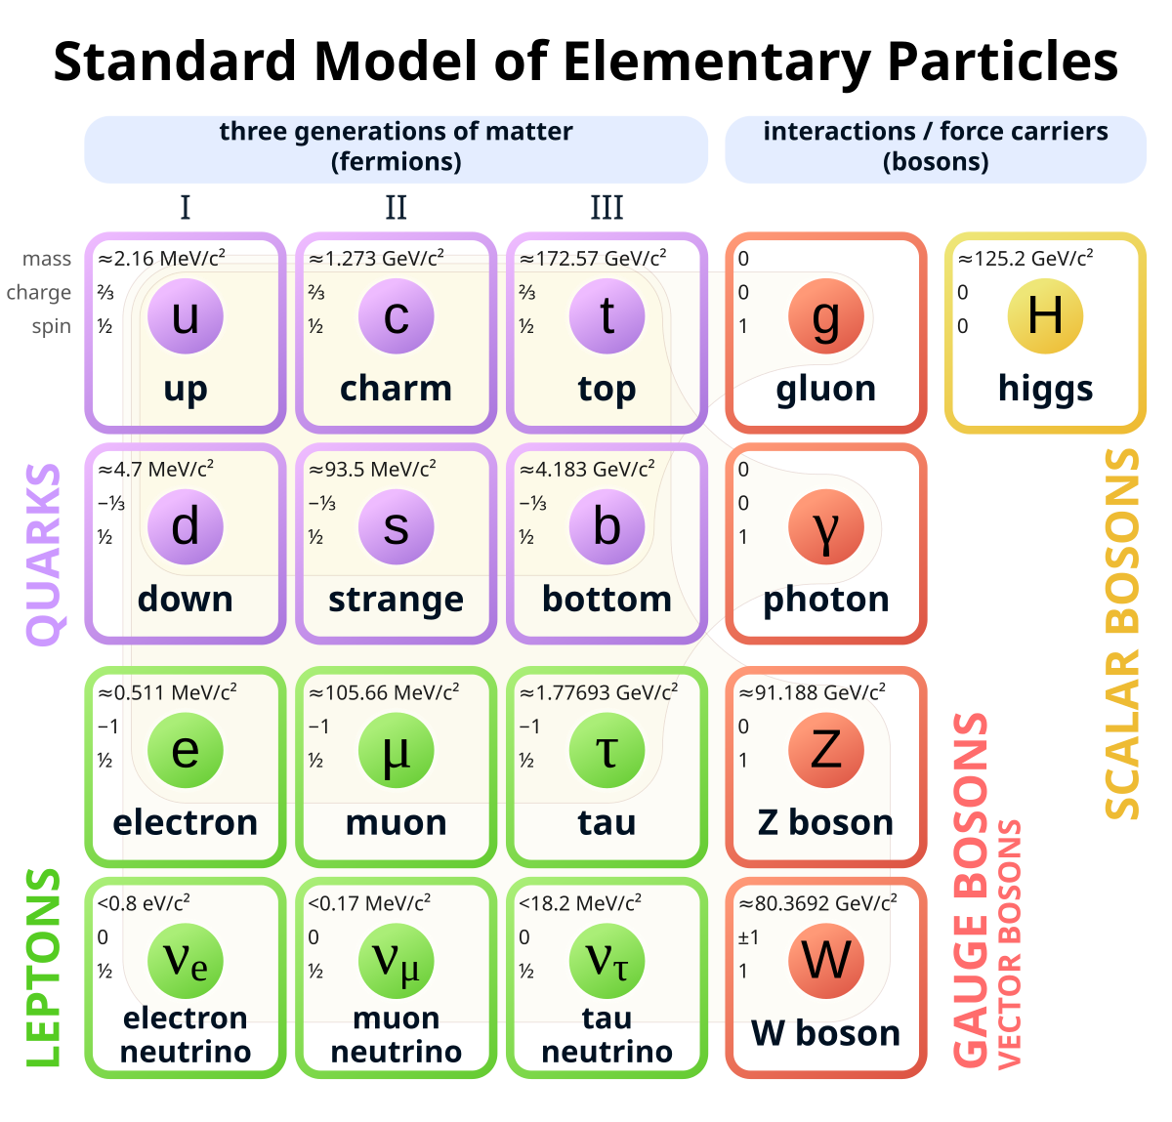
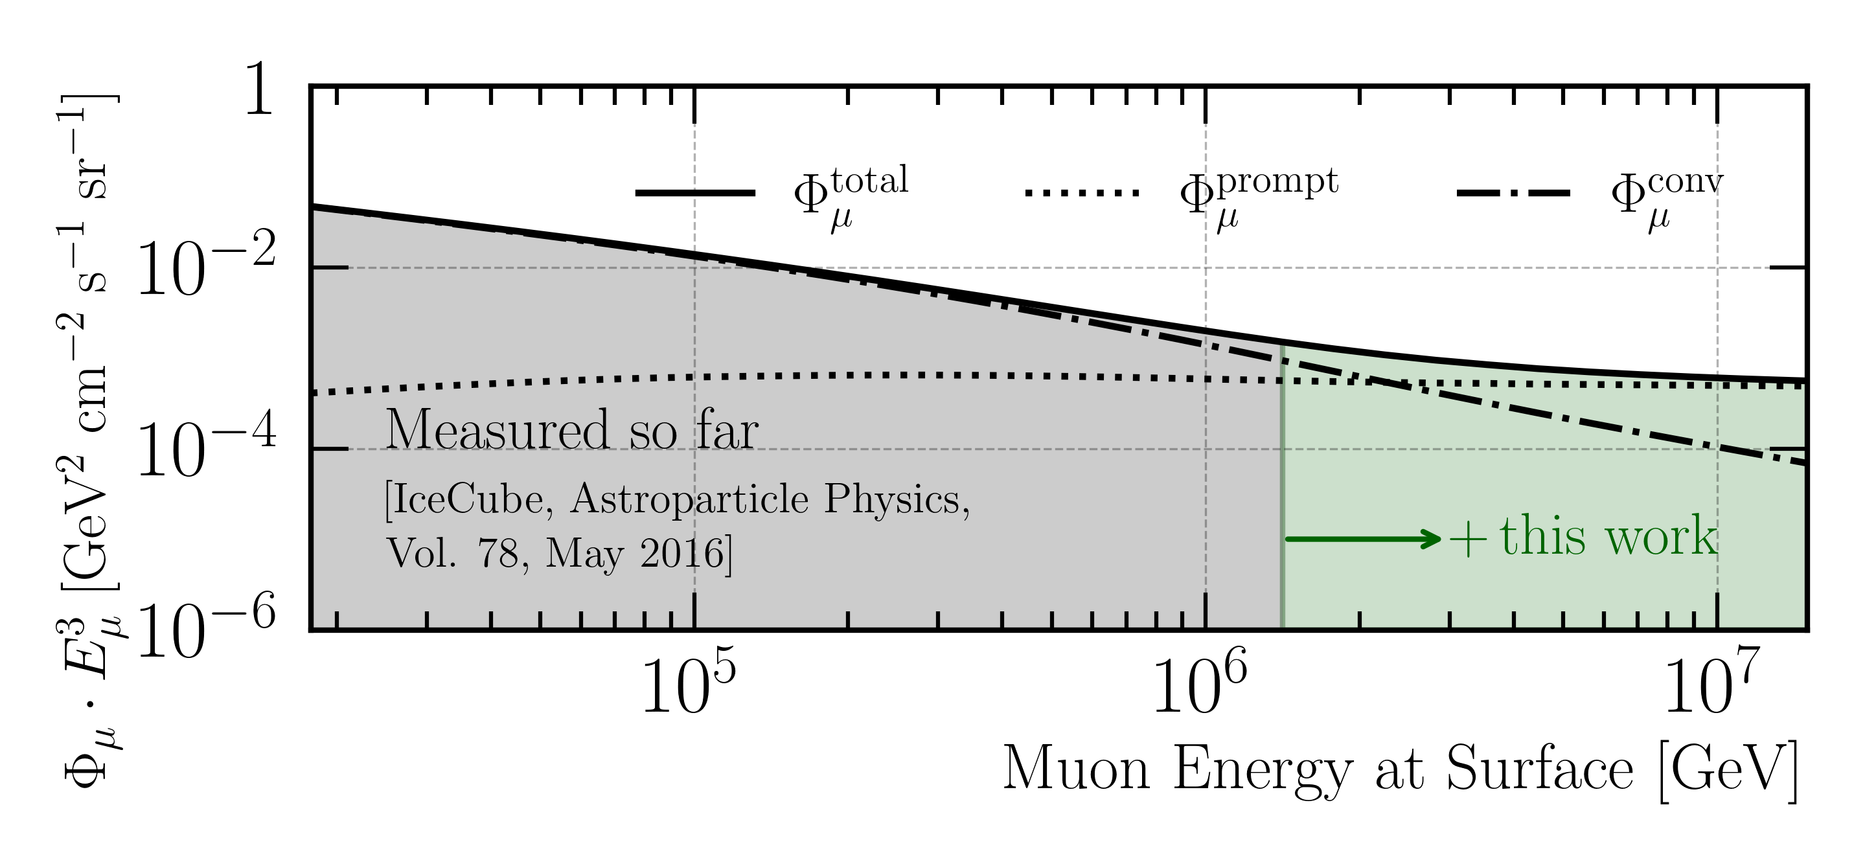
Atmospheric muon flux prediction
Unfold the “charm” of atmospheric muons

Slide 13
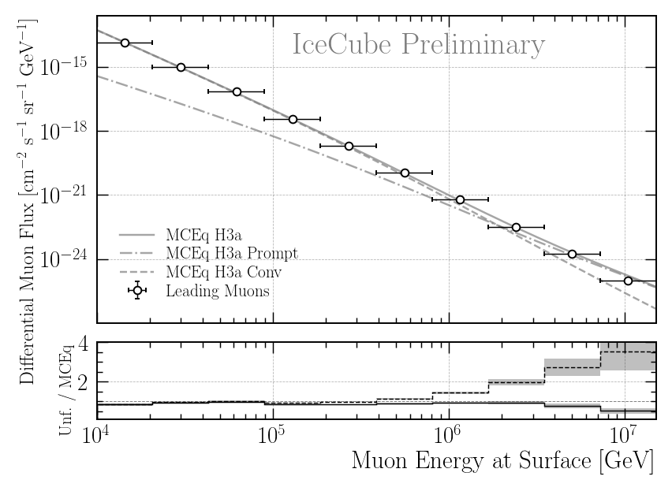
Conclusion & Outlook
Already measured
DNN-based reconstructions performed
Leading muon selection
Good Data—MC agreement
Muon flux at surface unfolded using 2487 h IceCube data
Flux agrees with prediction → already sensitive to charm (prompt)
Finalize analysis → unfold with more data
Extend energy range up to ~10 PeV
Prediction
Ratio to conv
Thank you for your attention!
Ratio to total

Slide 14

Introduction
Motivation
Characterize muon flux components and depth intensity
Probe hadronic interactions in the atmosphere
Constrain uncertainties and longstanding questions like the “muon puzzle”
Long term
Enhance understanding of hadronic processes relevant in distant astrophysical sources (e.g., supernovae, AGNs, …)
$φ_{tot}=φ_{prompt}+$ $φ_{conventional}$
Conventional Muon:
Parent is pion or kaon
Credit: Ludwig Neste

Slide 15
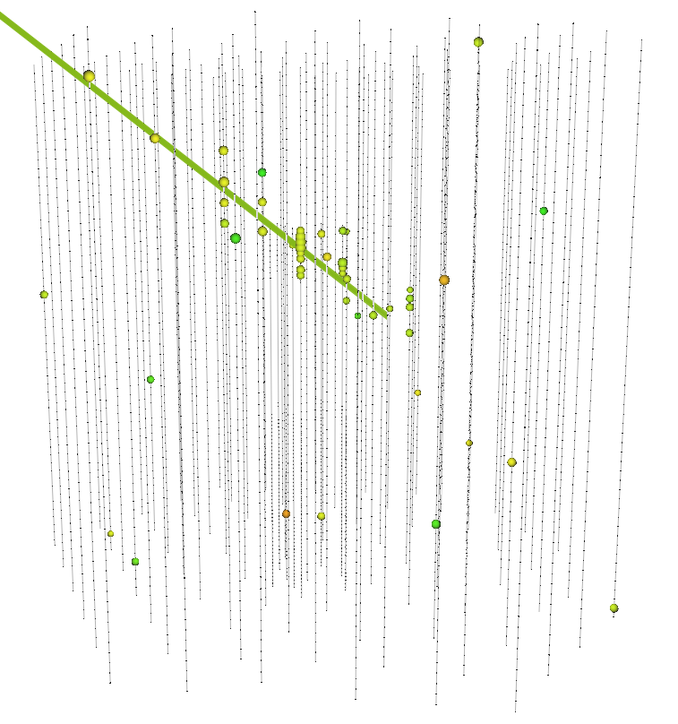
Stopping and Leading Muons
Leading muons:
Most energetic muon in the bundle
High energies above 10 TeV
Focus on muons carrying > 40% of the entire bundle
Stopping muons:
Stop (decay) inside the in-ice array
Stopping point + direction → propagated length
Proxy to muon energy at the surface
Low-energy muons

Slide 16
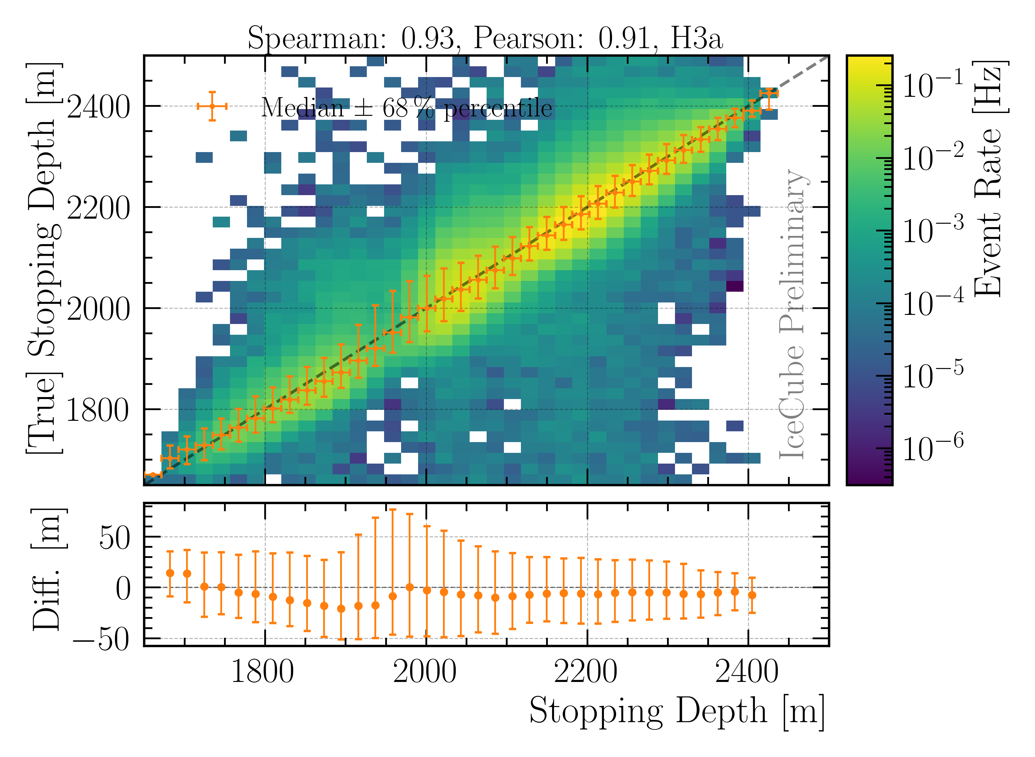
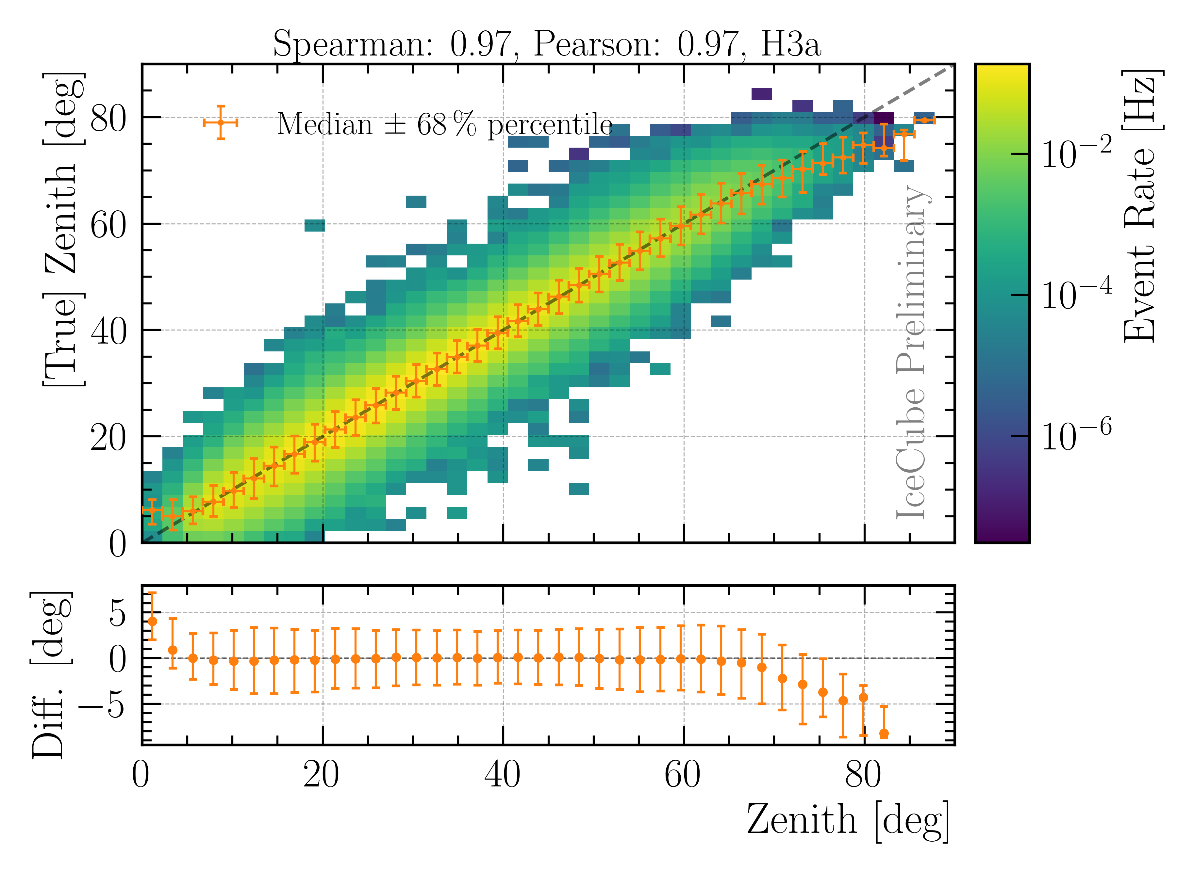
Reconstructions: Stopping Muons
Good reconstruction of stopping depth and zenith angle
Calculate propagation length → proxy variable for unfolding

Slide 17
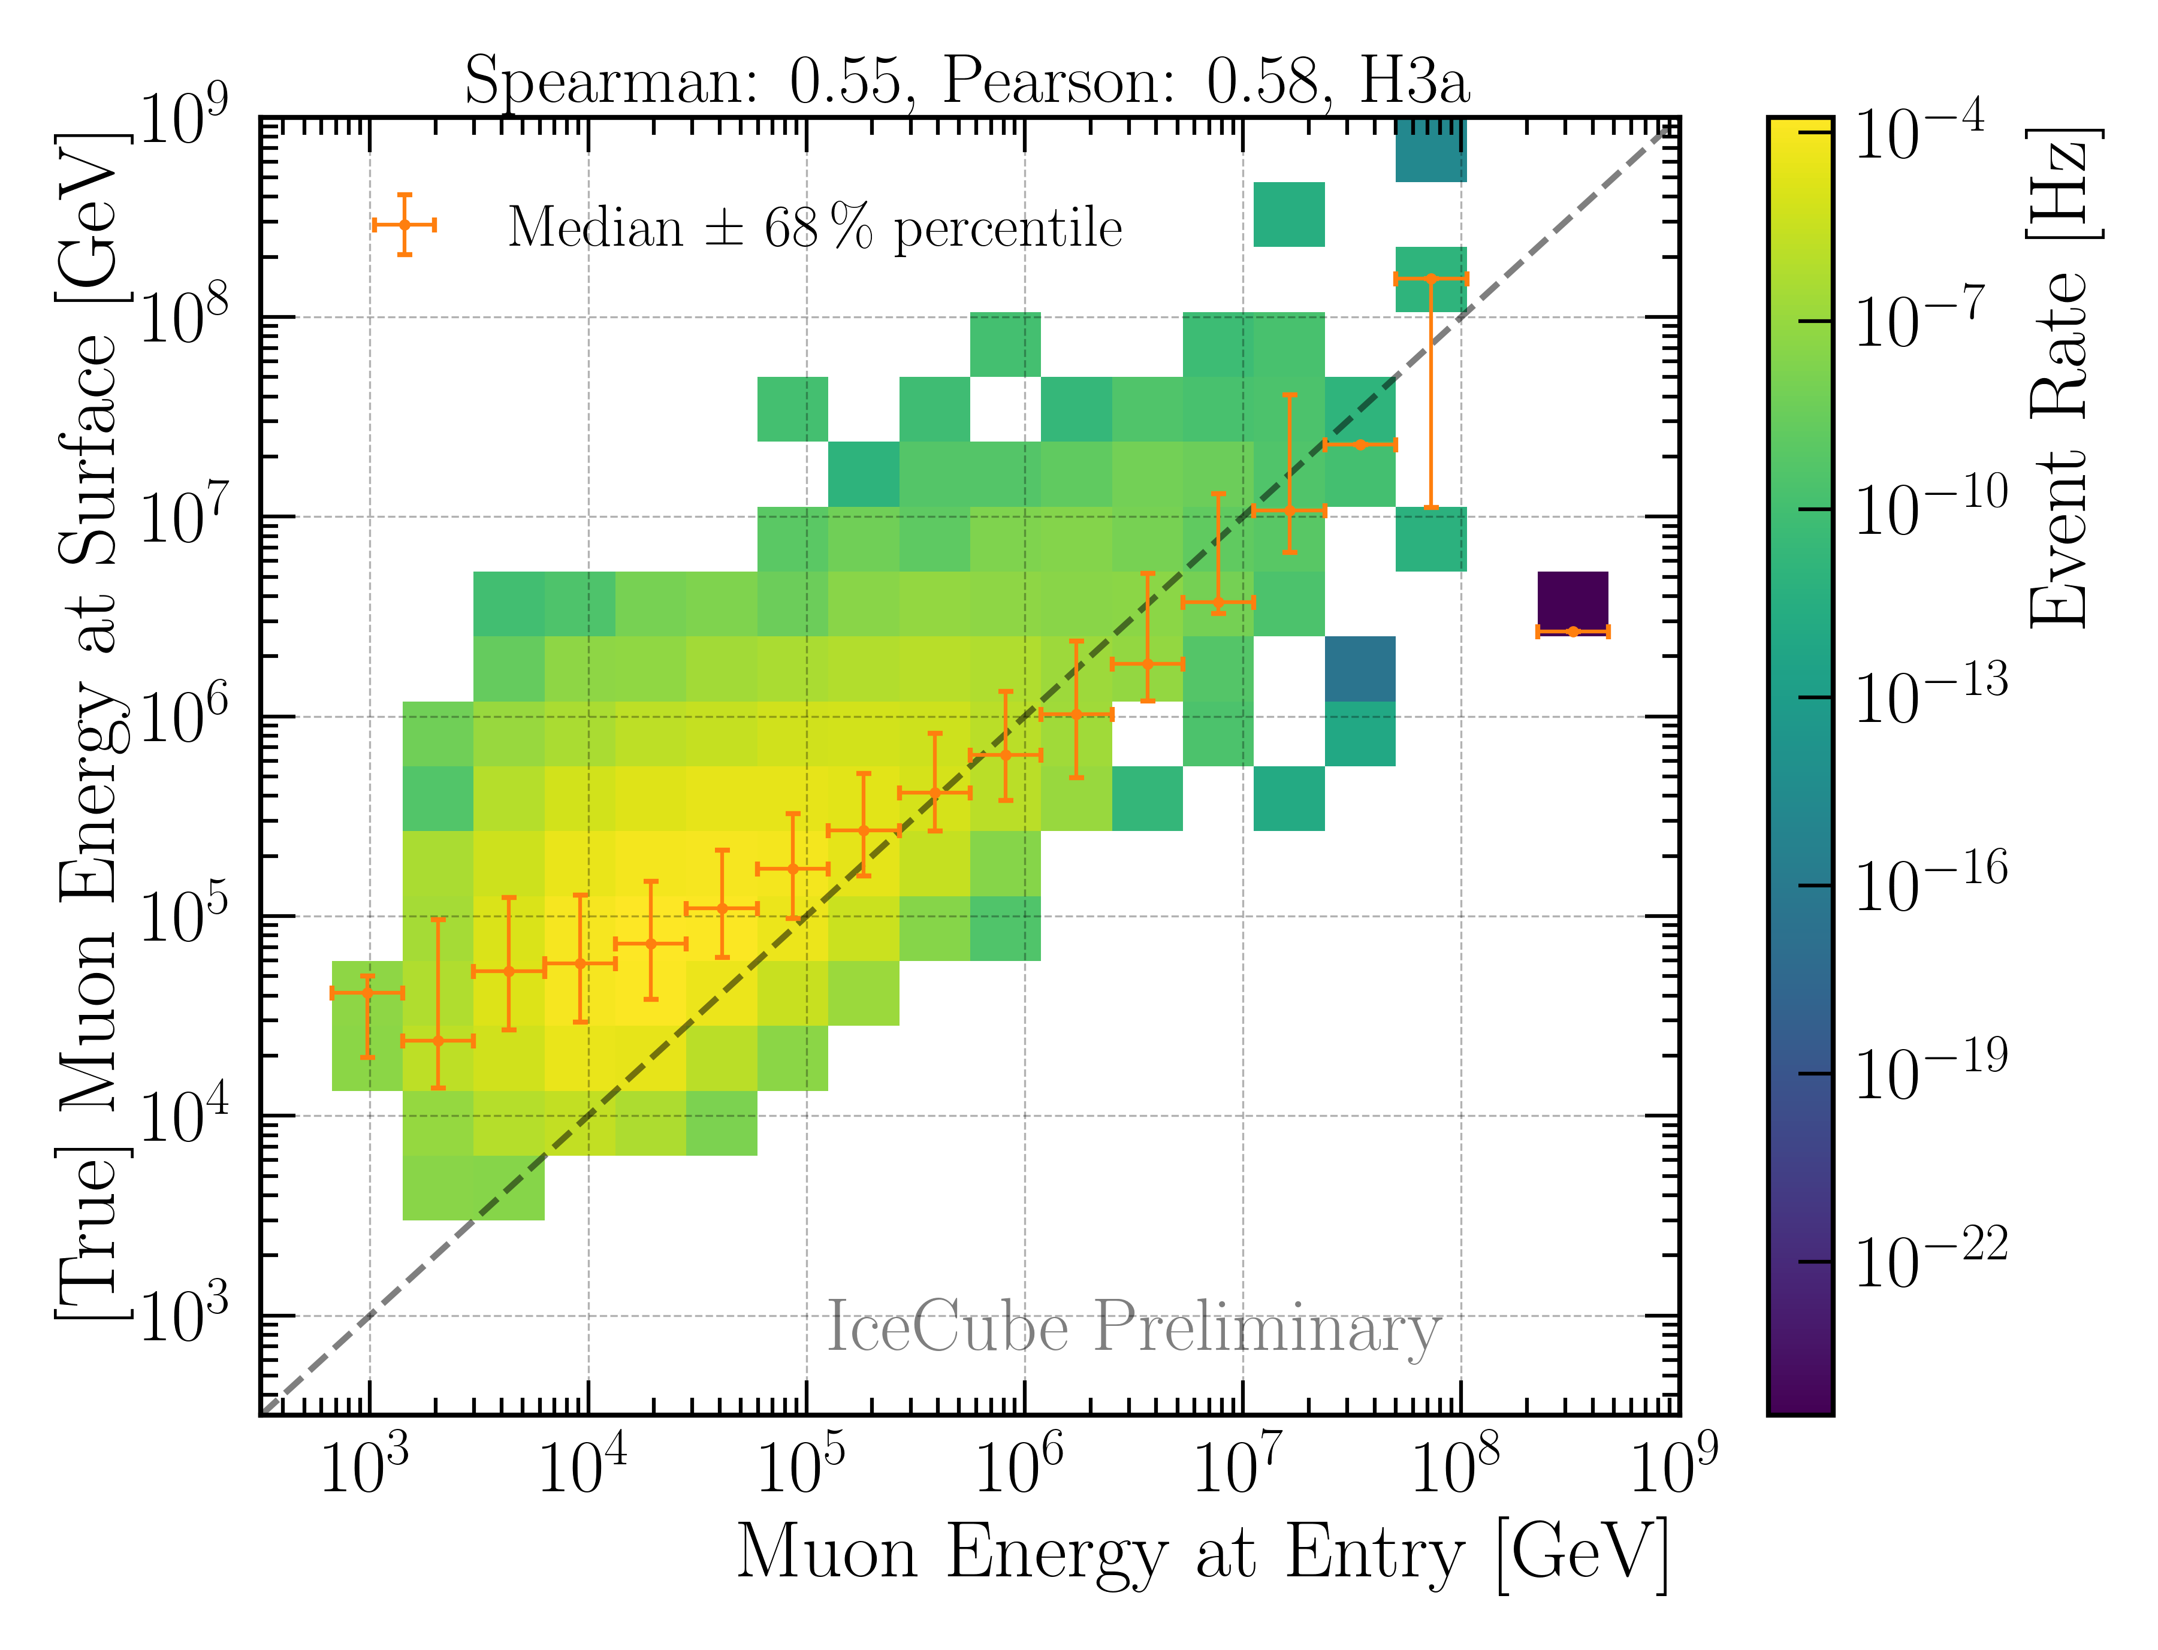
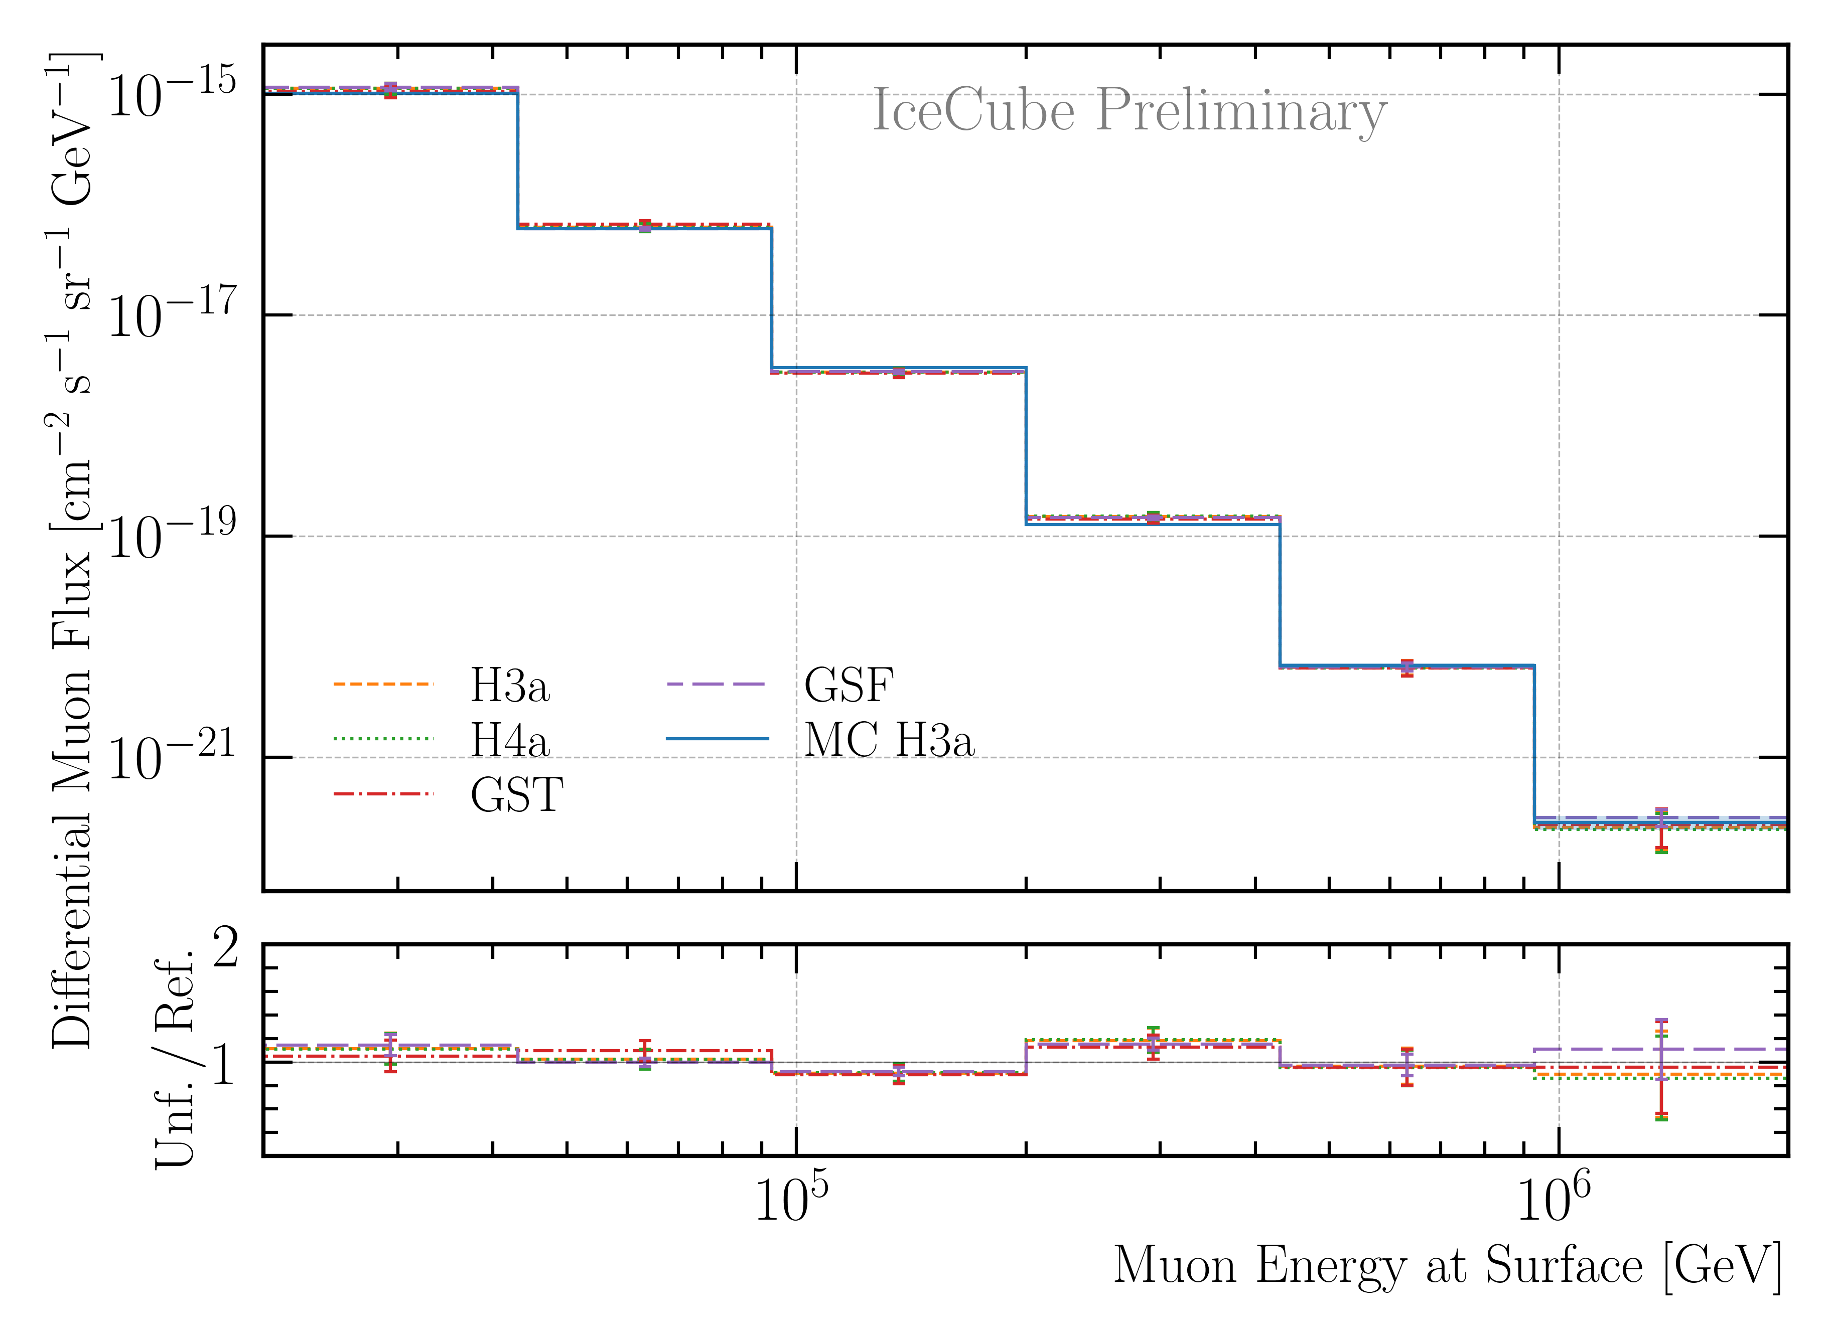
Correlation and Robustness Test: Leading Muons
Build unfolding matrix on H3a, H4a, GST & GSF
Unfold H3a as test set
Results are within uncertainties → robust
Correlation between proxy and target

Slide 18
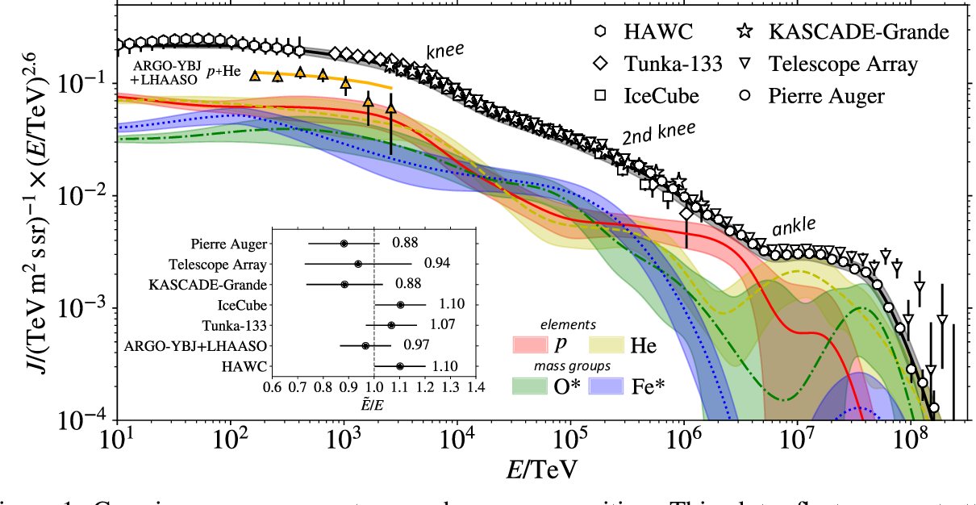
Cosmic ray flux
Arxiv: 1903.07713
Notes:
1. Knee: ~3 PeV, before gamma = 2.7, limit of acceleration mechanism for cosmic rays in supernova remnants 2. Knee: ~100 PeV, before gamma = 3.1, heavier elements, like iron, from galactic sources start to reach their maximum acceleration energy → more protons, larger energy in electromagnetic acceleration Ankle: ~1 EeV, flattens out again, transition point between galactic and extra galactic particle origin,

Slide 19
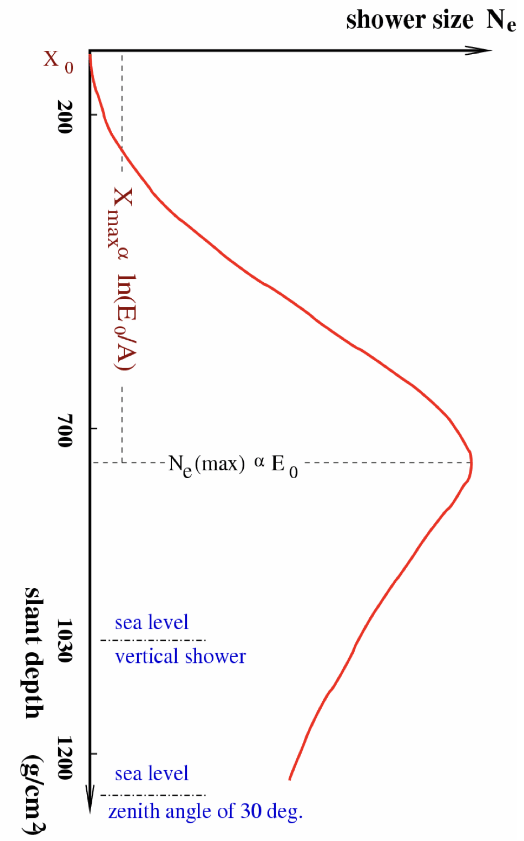
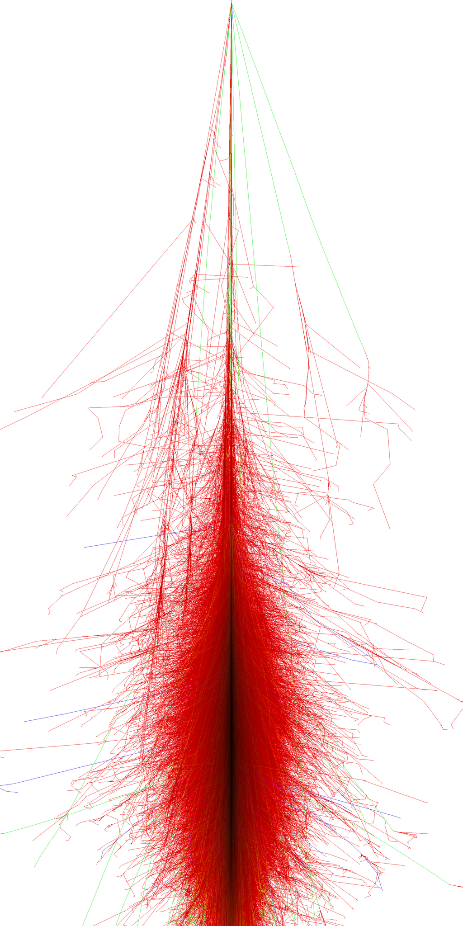
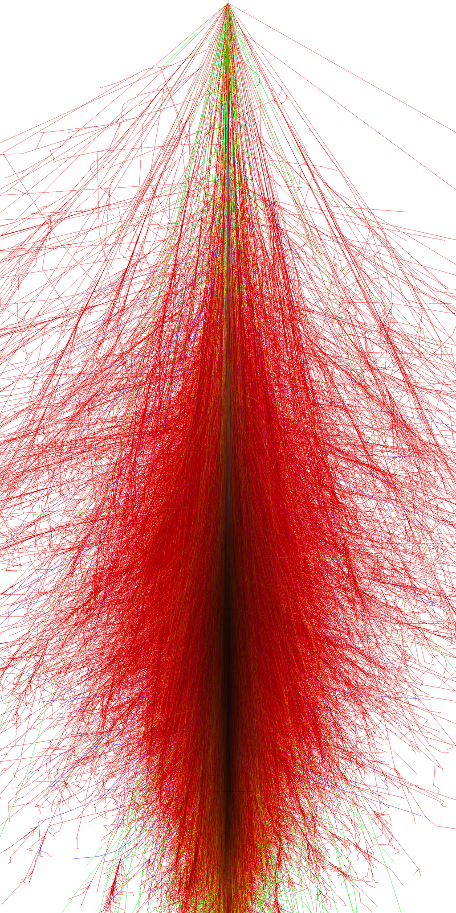
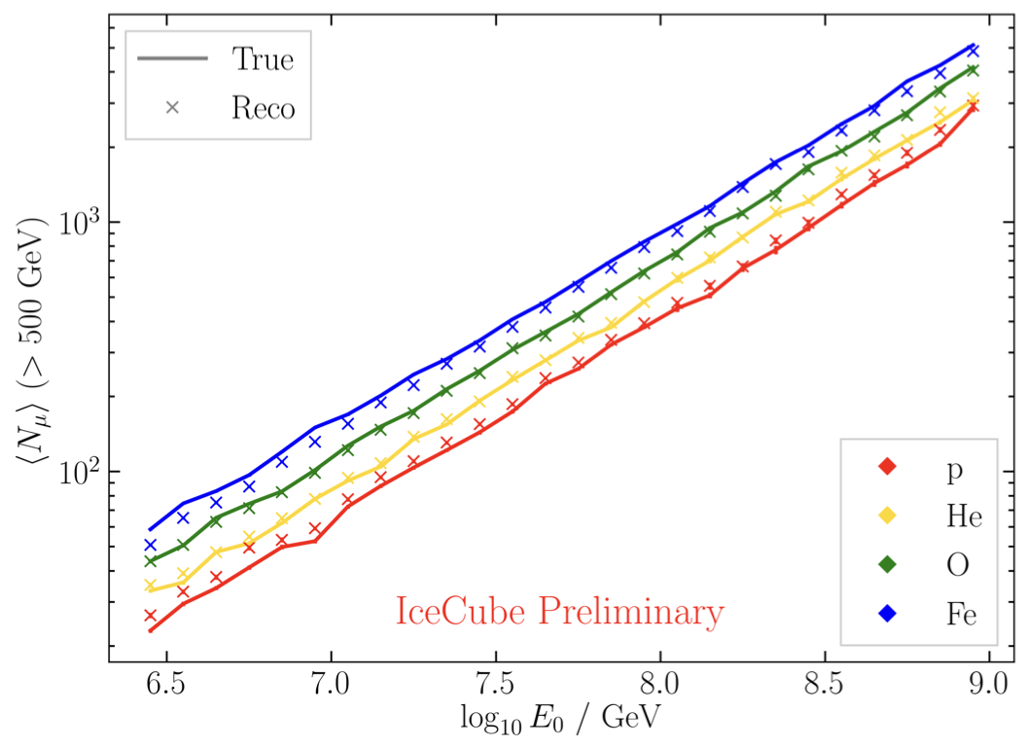
Air shower – 10 TeV
Ralph Engel 2005
“muon bundles”
2211.16970v2
Proton
www.iap.kit.edu/corsika
Iron
Notes:
shower maximum: x_max, slant depth at which the number of particles is the greatest, more energetic and lighter cosmic rays produce deeper/lower x_max, while heavier nuclei have a higher shower maximum
measure number of particles / muons
lateral spread
nitrogen can be excited → fluorescence light emitted
iron produces more muons than proton, because it has 56 nucleons → higher fragmentation → “sub-showers”

Slide 20
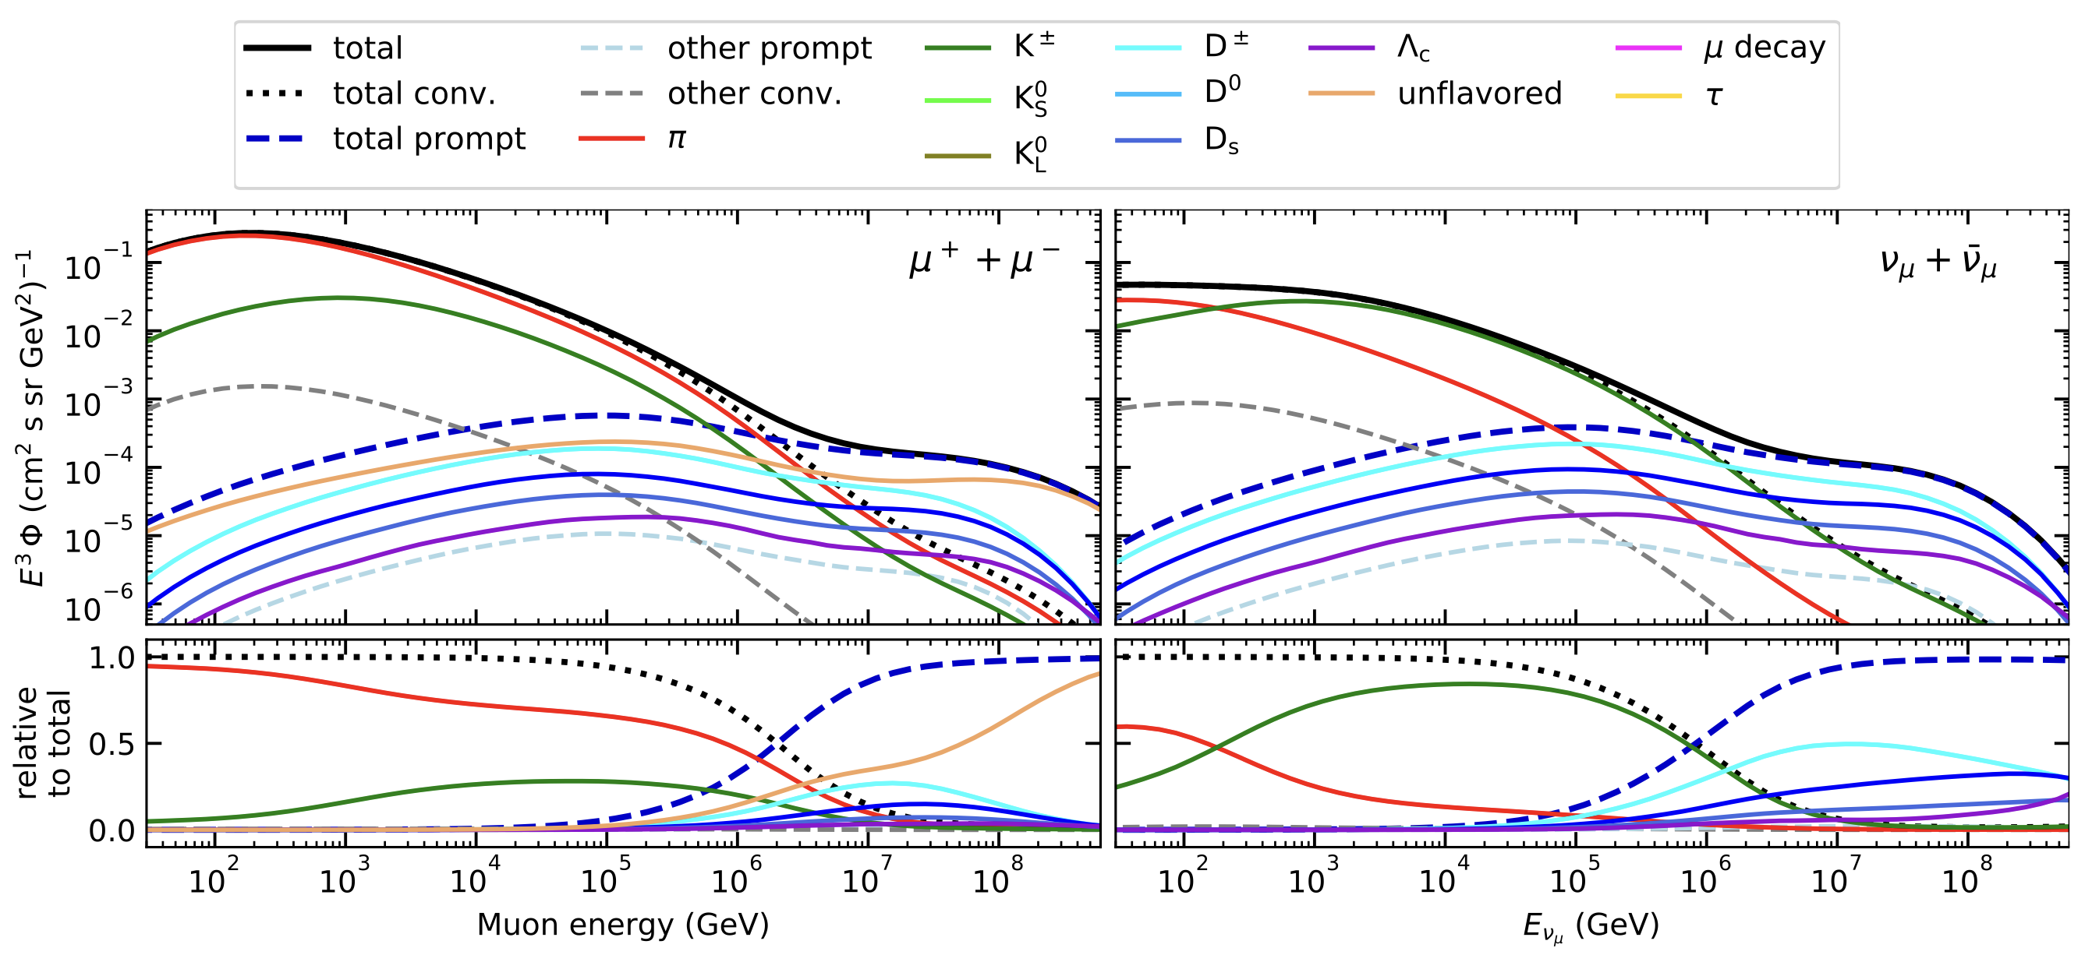
Prompt atmospheric muons and neutrinos
10.1103/PhysRevD.100.103018
no unflavored
dominated by pions
dominated by kaons
Combined fit:
handle on pion/kaon ratio
handle on charmed mesons

Slide 21
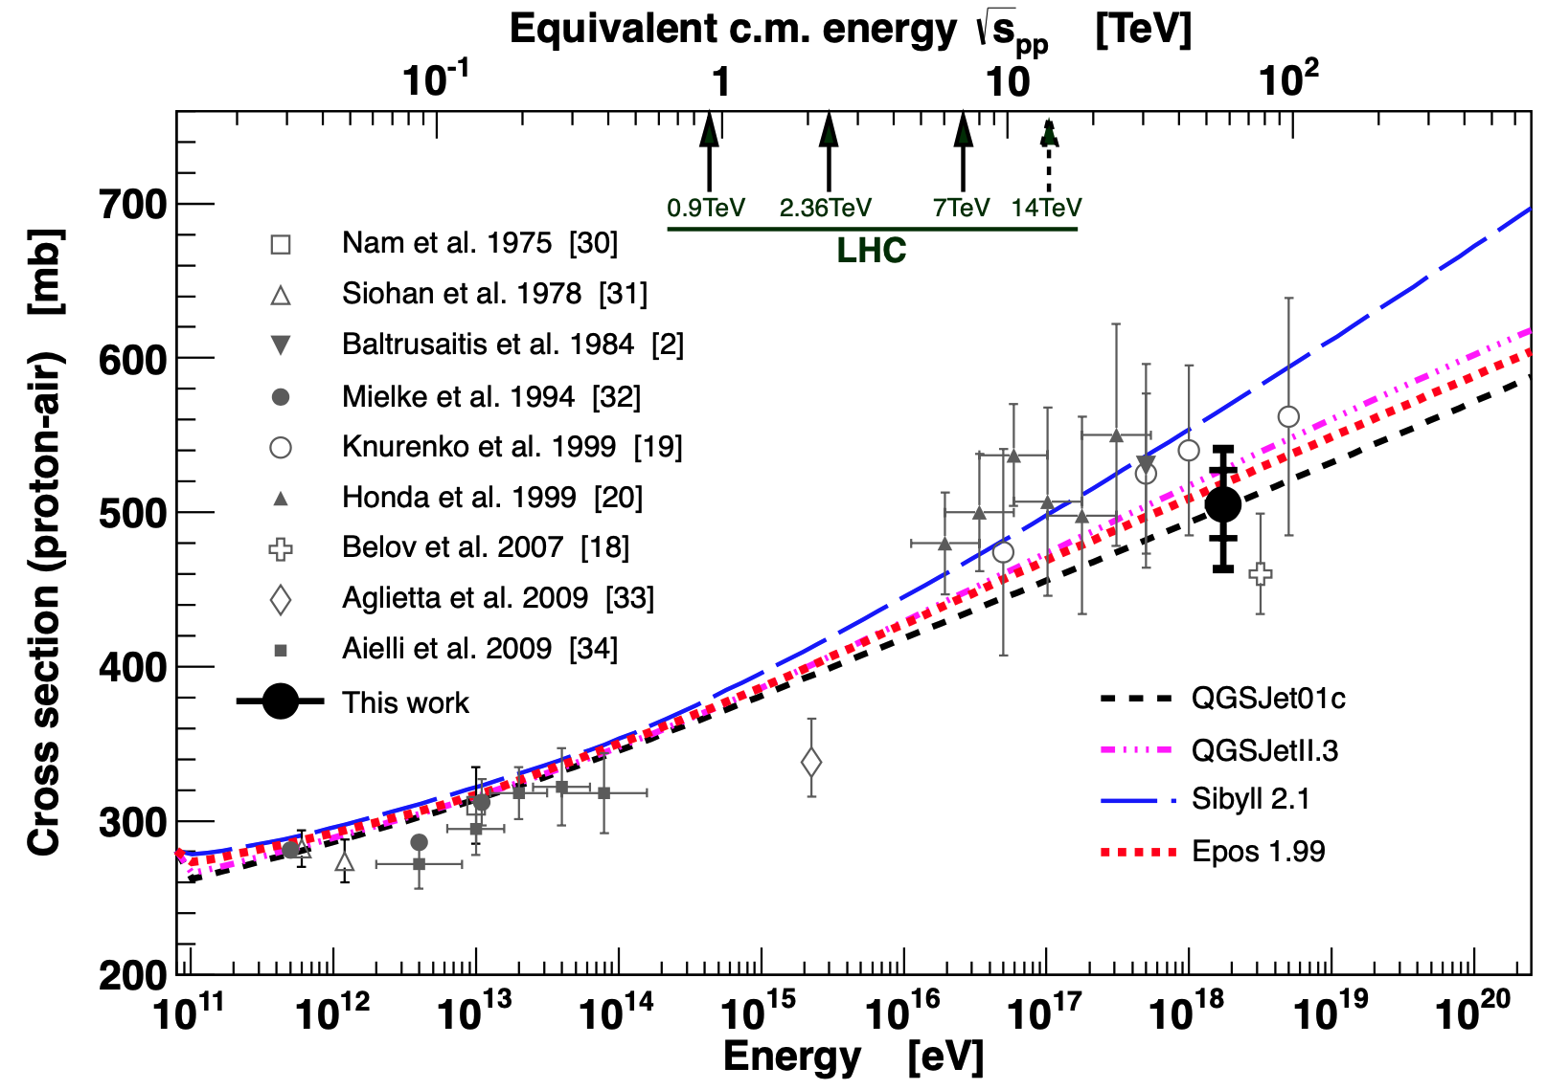
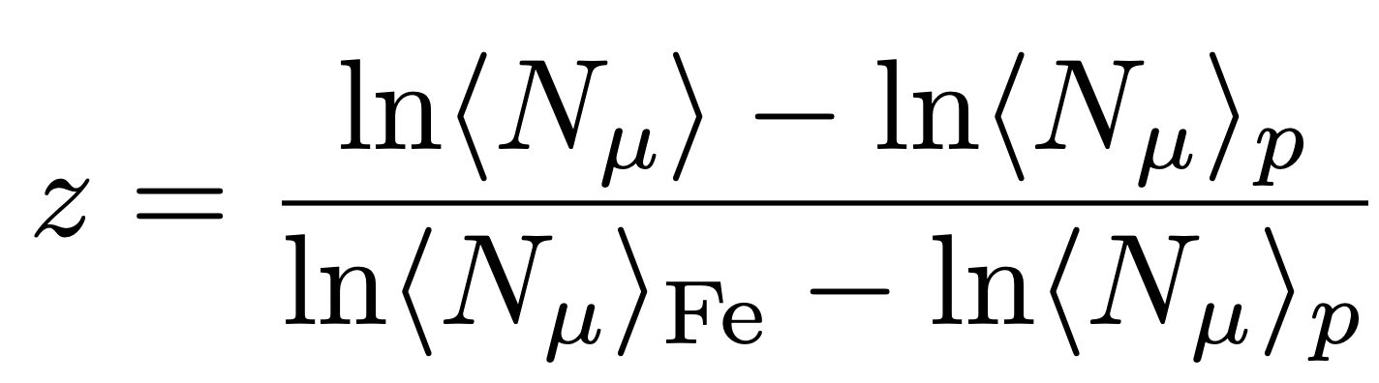
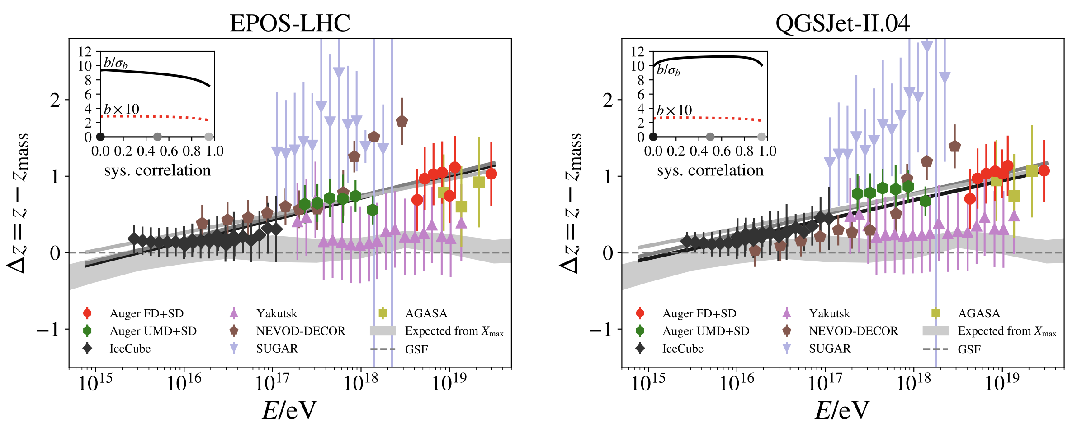
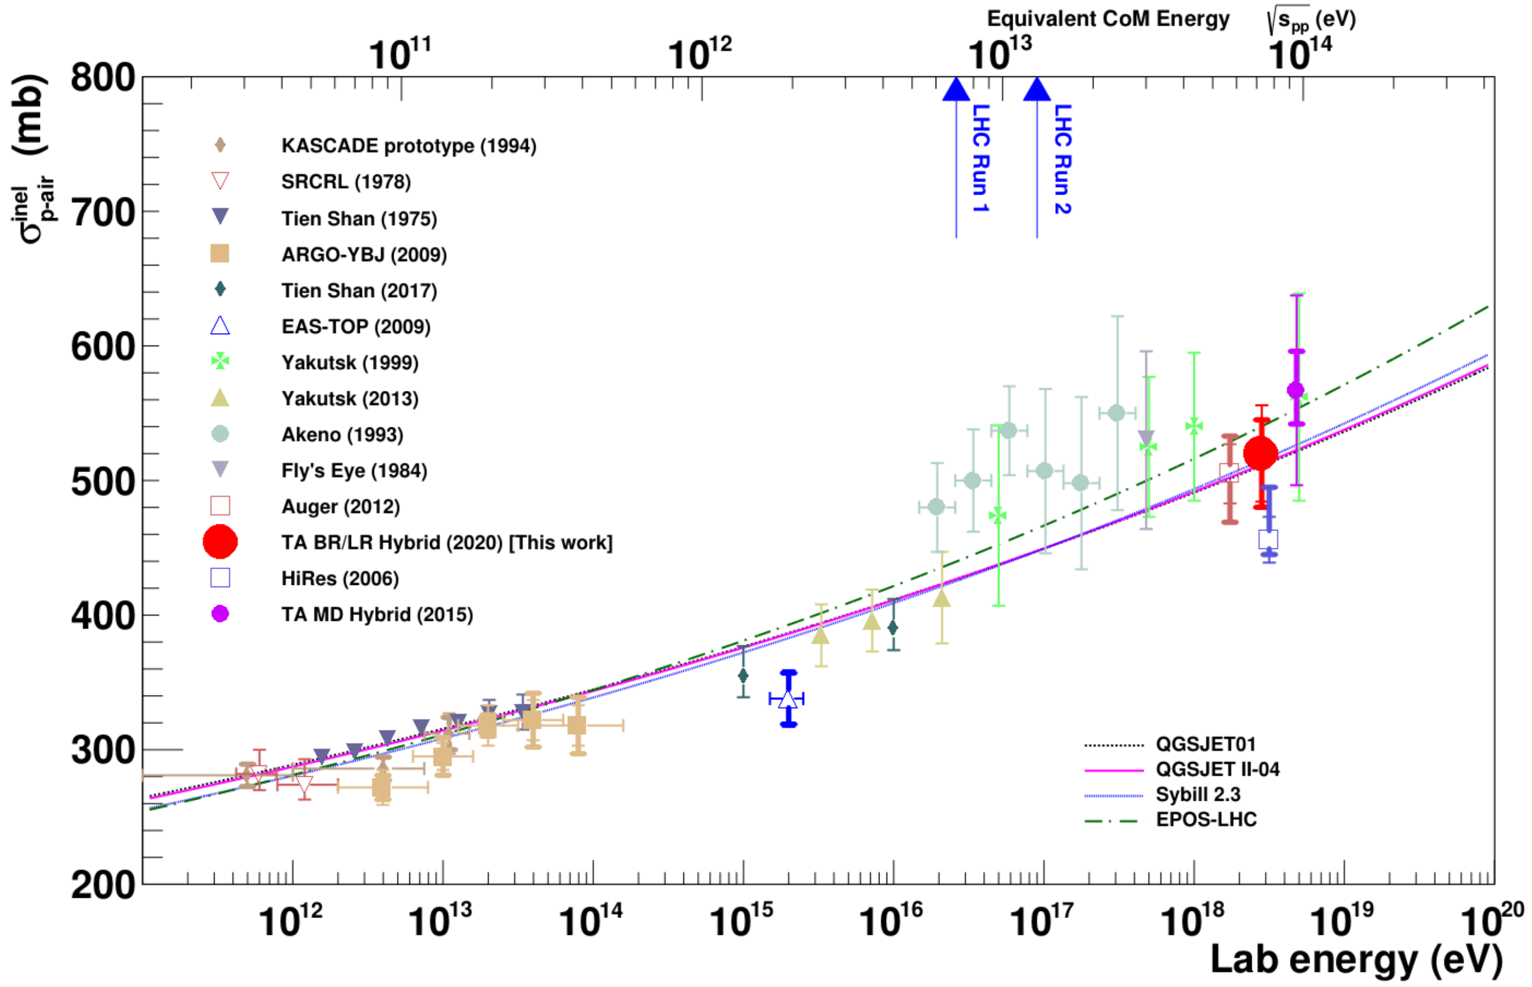
Muon puzzle and model uncertainties
”muon number”
Expected z
(“muon number”)
2012
2108.08341
1208.1520
Uncertainties at E > 10 PeV
2020
More muons measured than simulated for E > 40 PeV ~ cms 8 TeV
2006.05012

Slide 22
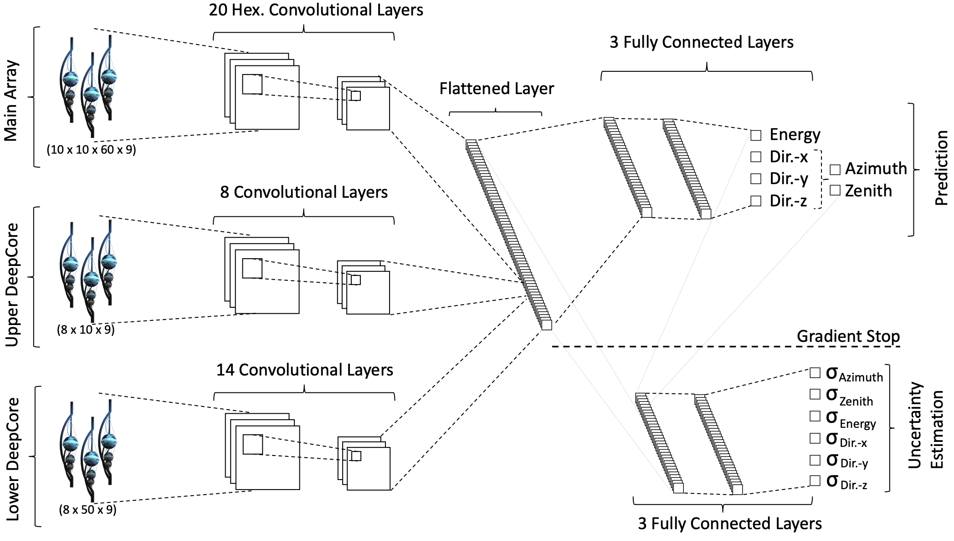
Convolutional Neural Network (CNN)
Machine learning approach:
fast
identifying spatial patterns
better event reconstruction and classification
2101.11589

Slide 23
Input data per DOM
10.1088/1748-0221/16/07/P07041
3 inputs
c_{total}: Total charge
Sum of charge
t_{first}: Relative time of first pulse
Relative to total time offset, calculated as the charge weighted mean time of all pulses
t_{std}: Standard deviation of first pulse
Charge weighted standard deviation of pulse times relative to total time offset
9 inputs
t_{last}: Relative time of last pulse
Relative to total time offset, calculated as the charge weighted mean time of all pulses
t_{20%}: Relative time of 20% charge
Relative to total time offset, calculated as the charge weighted mean time of all pulses
t_{50%}: Relative time of 50% charge
Relative to total time offset, calculated as the charge weighted mean time of all pulses
t_{mean}: Mean time
Charge weighted mean time of all pulses relative to total time offset
c_{500ns}: Charge at 500ns
Sum of charge after 500ns
c_{100ns}: Charge at 100ns
Sum of charge after 100ns
Input pulses
SplitInIceDSTPulses
SplitInIceDSTPulsesTWCleaning6000ns
(DNN framework performs an internal cleaning)
Training datasets
20904
21962
22020
22187

Slide 24
Reconstructed properties
Energy
entry_energy: Leading muon energy at the detector entry
bundle_energy_at_entry: Muon bundle energy at the detector entry
muon_energy_first_mctree: Leading muon energy at surface
bundle_energy_in_mctree: Muon bundle energy at surface
Track geometry
Length: Propagation length of muon in the ice
LengthInDetector: Propagation length of muon in the detector
center_pos_x: Closest x position of muon to center of the detector
center_pos_y: Closest y position of muon to center of the detector
center_pos_z: Closest z position of muon to center of the detector
center_pos_t: Time of closest approach to the center of the detector
entry_pos_x: x position of muon at the detector entry
entry_pos_y: y position of muon at the detector entry
entry_pos_z: z position of muon at the detector entry
entry_pos_t: Time of muon at the detector entry
Direction
zenith: Zenith angle of muon
azimuth: Azimuth angle of muon
Network 1
Network 0: Muon bundle energy at surface (fast pre-cut)
Network 2
Network 3

Slide 25
Level5: quality cuts
containment cuts | > | <
length in detector | 1000 m | 2000 m
entry pos x, y | -750 m | 750 m
entry pos z | -500 m | 750 m
center pos x, y | -550 m | 550 m
center pos z | -650 m | 650 m
uncertainty cuts | <
bundle energy at entry | 0.9 log10(GeV)
bundle energy at surface | 2.0 log10(GeV)
zenith | 0.1 rad
azimuth | 0.2 rad
entry pos x , y, z | 42 m
center pos x, y, z | 50 m
entry pos time | 200 ns
center pos time | 600 ns
length in detector | 160 m
length | 2000 m
neutrino cuts | > | <
cos(zenith) | 0.2
length | 5000 m | 15000 m

Slide 26
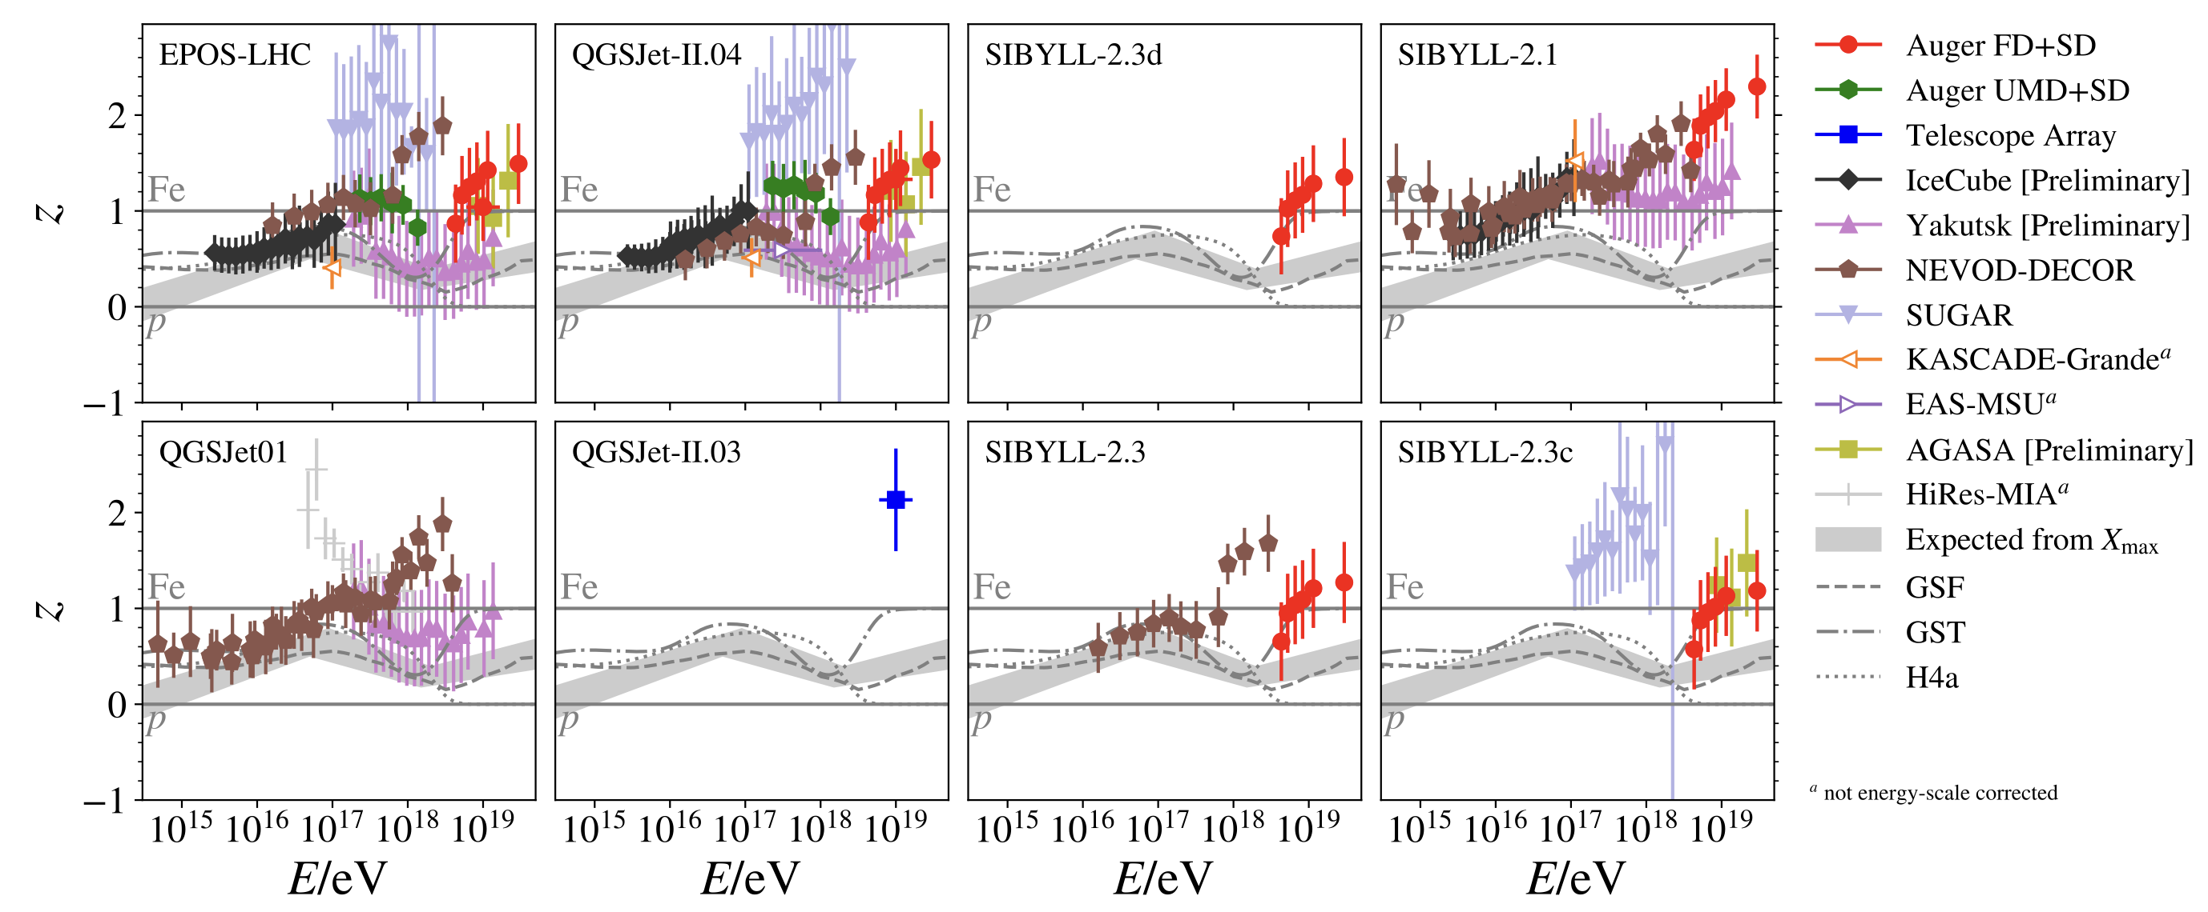
The Muon Puzzle
”muon number”
Arxiv: 2108.08341

Slide 27
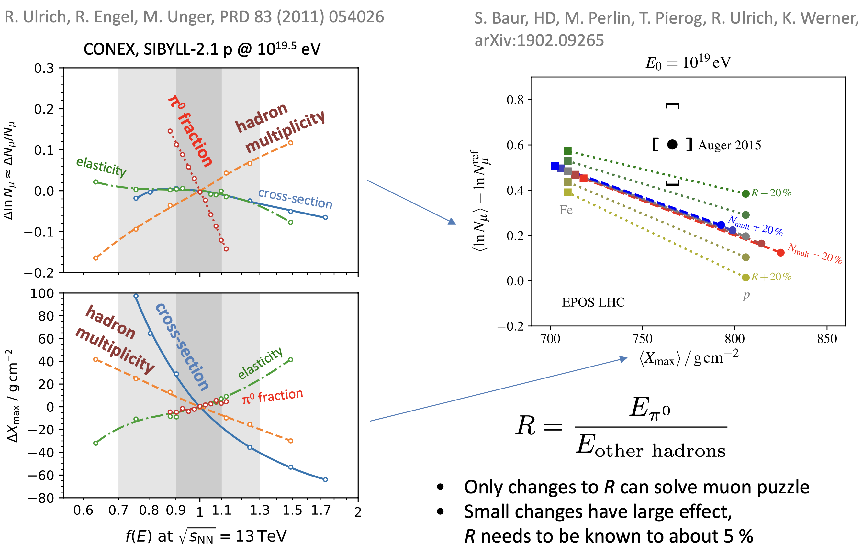
Possible Solutions
Slide taken from Hans Dembinski

